Slide 1



Open Data
Peter Murray-Rust*,
Open Knowledge and University of Cambridge
European Bioinformatics Institute, UK, 2014-05-15
*Shuttleworth Fellow 2014-5
Notes:
Hi, I’m here to talk about AMI; a data extraction framework and tool. First, I just want highlight some of key contributors to the projects; Andy for his work on the ChemistryVisitor and Peter for the overall architecture.
In this talk, I’m going to impress the importance of data in a specific format and its utility to automated machine processing. Then I’m going to demonstrate AMI’s architecture and the transformation of data as it flows through the process. I’m going to dwell a little on a core format used, Scalable Vector Graphics (SVG) before introducing the concept of visitors, which are pluggable context specific data extractors. Next, I’m going to introduce Andy’s ChemVisitor, for extracting semantic chemistry data, along with a few other visitors that can process non-chemistry specific data. Finally, I will demonstrate some uses of the ChemVisitor, within the realm of validation and metabolism.

Slide 2
Overview
Most scientific data is lost; costs many billions…
… AND LIVES. Closed Data Means People Die
Human problem; lack of vision + active opposition.
Fully open data can change this
Appreciation of Jean-Claude Bradley’s work
Panton Fellows (Ross Mounce, Sophie Kershaw)
Content Mining as partial solution (Hargreaves UK)
WHAT YOU MUST DO

Slide 3
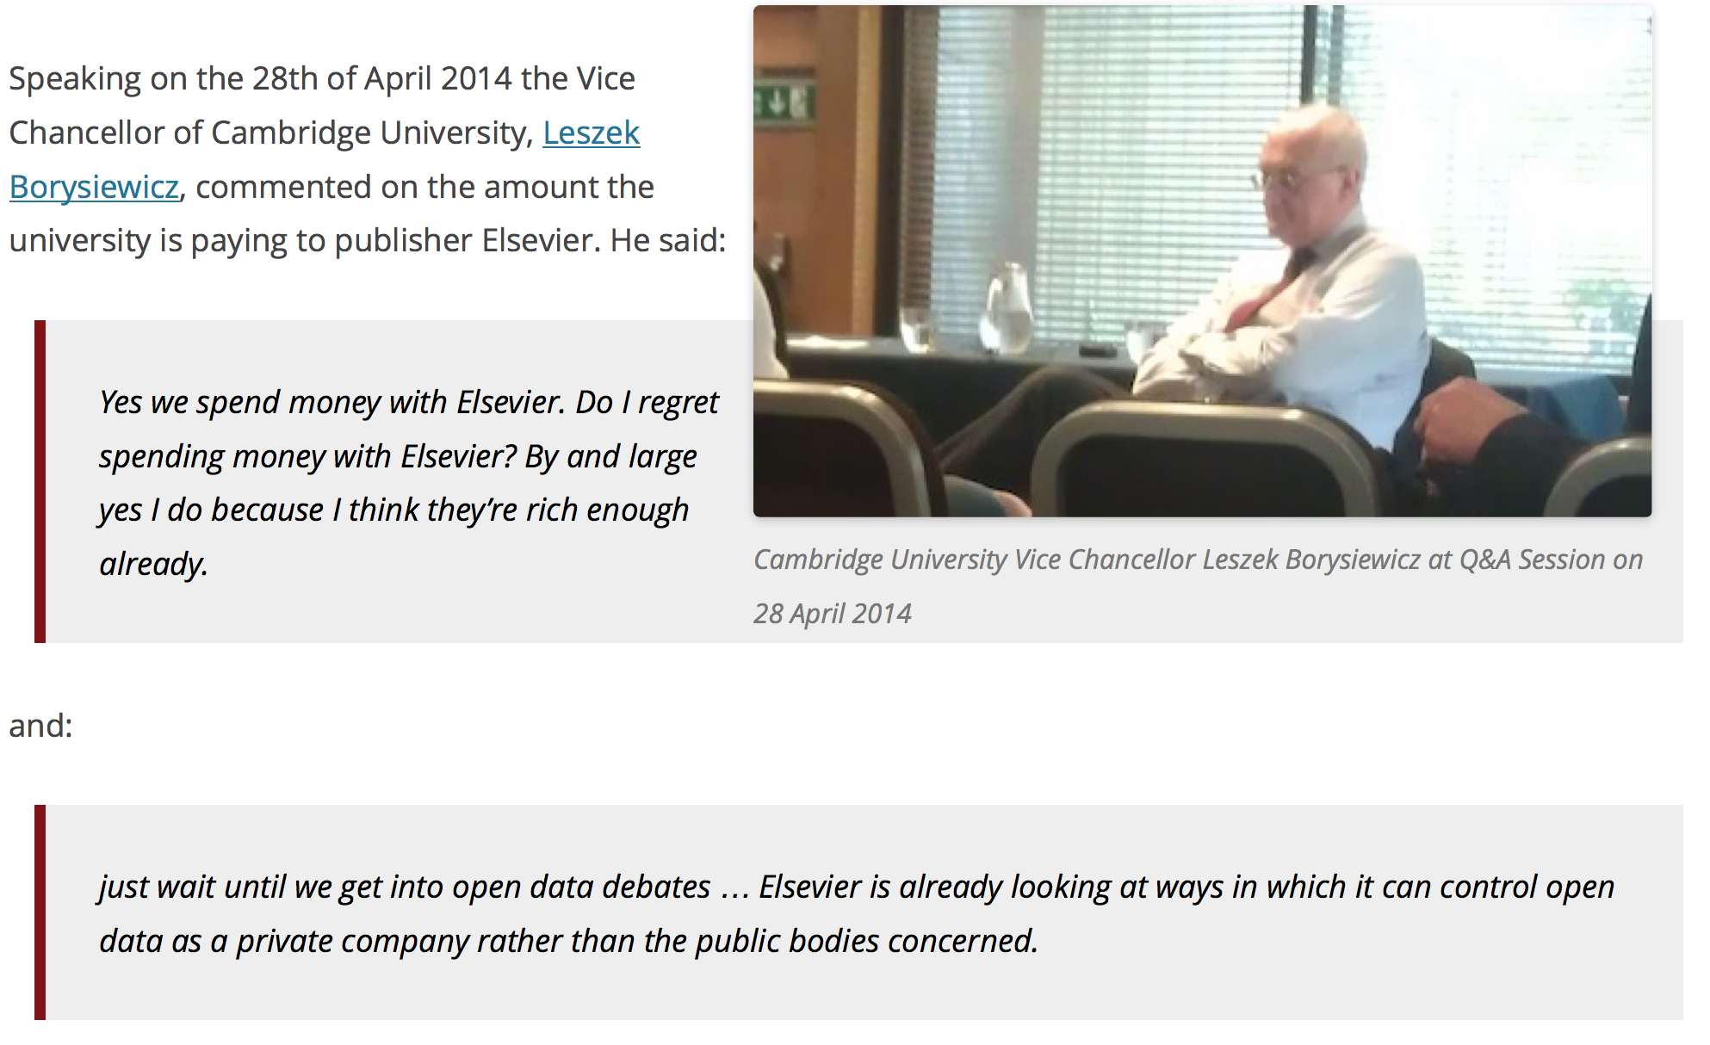
Elsevier wants to control Open Data

Slide 4
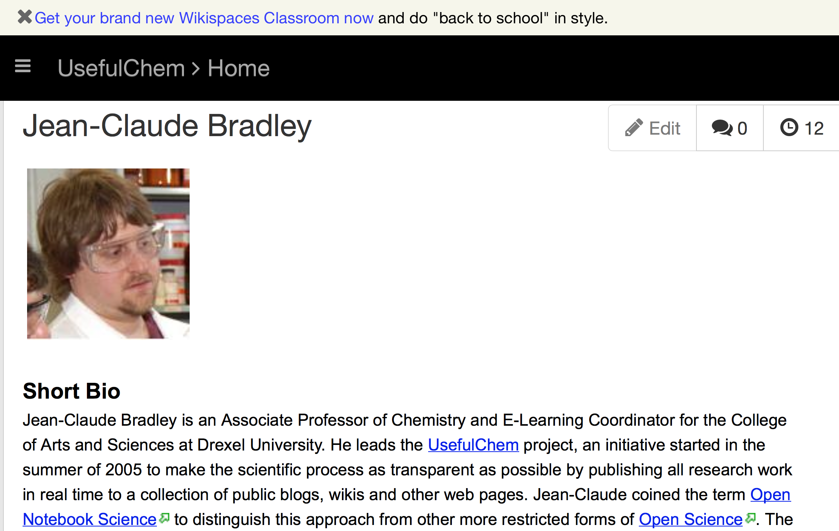

Slide 5
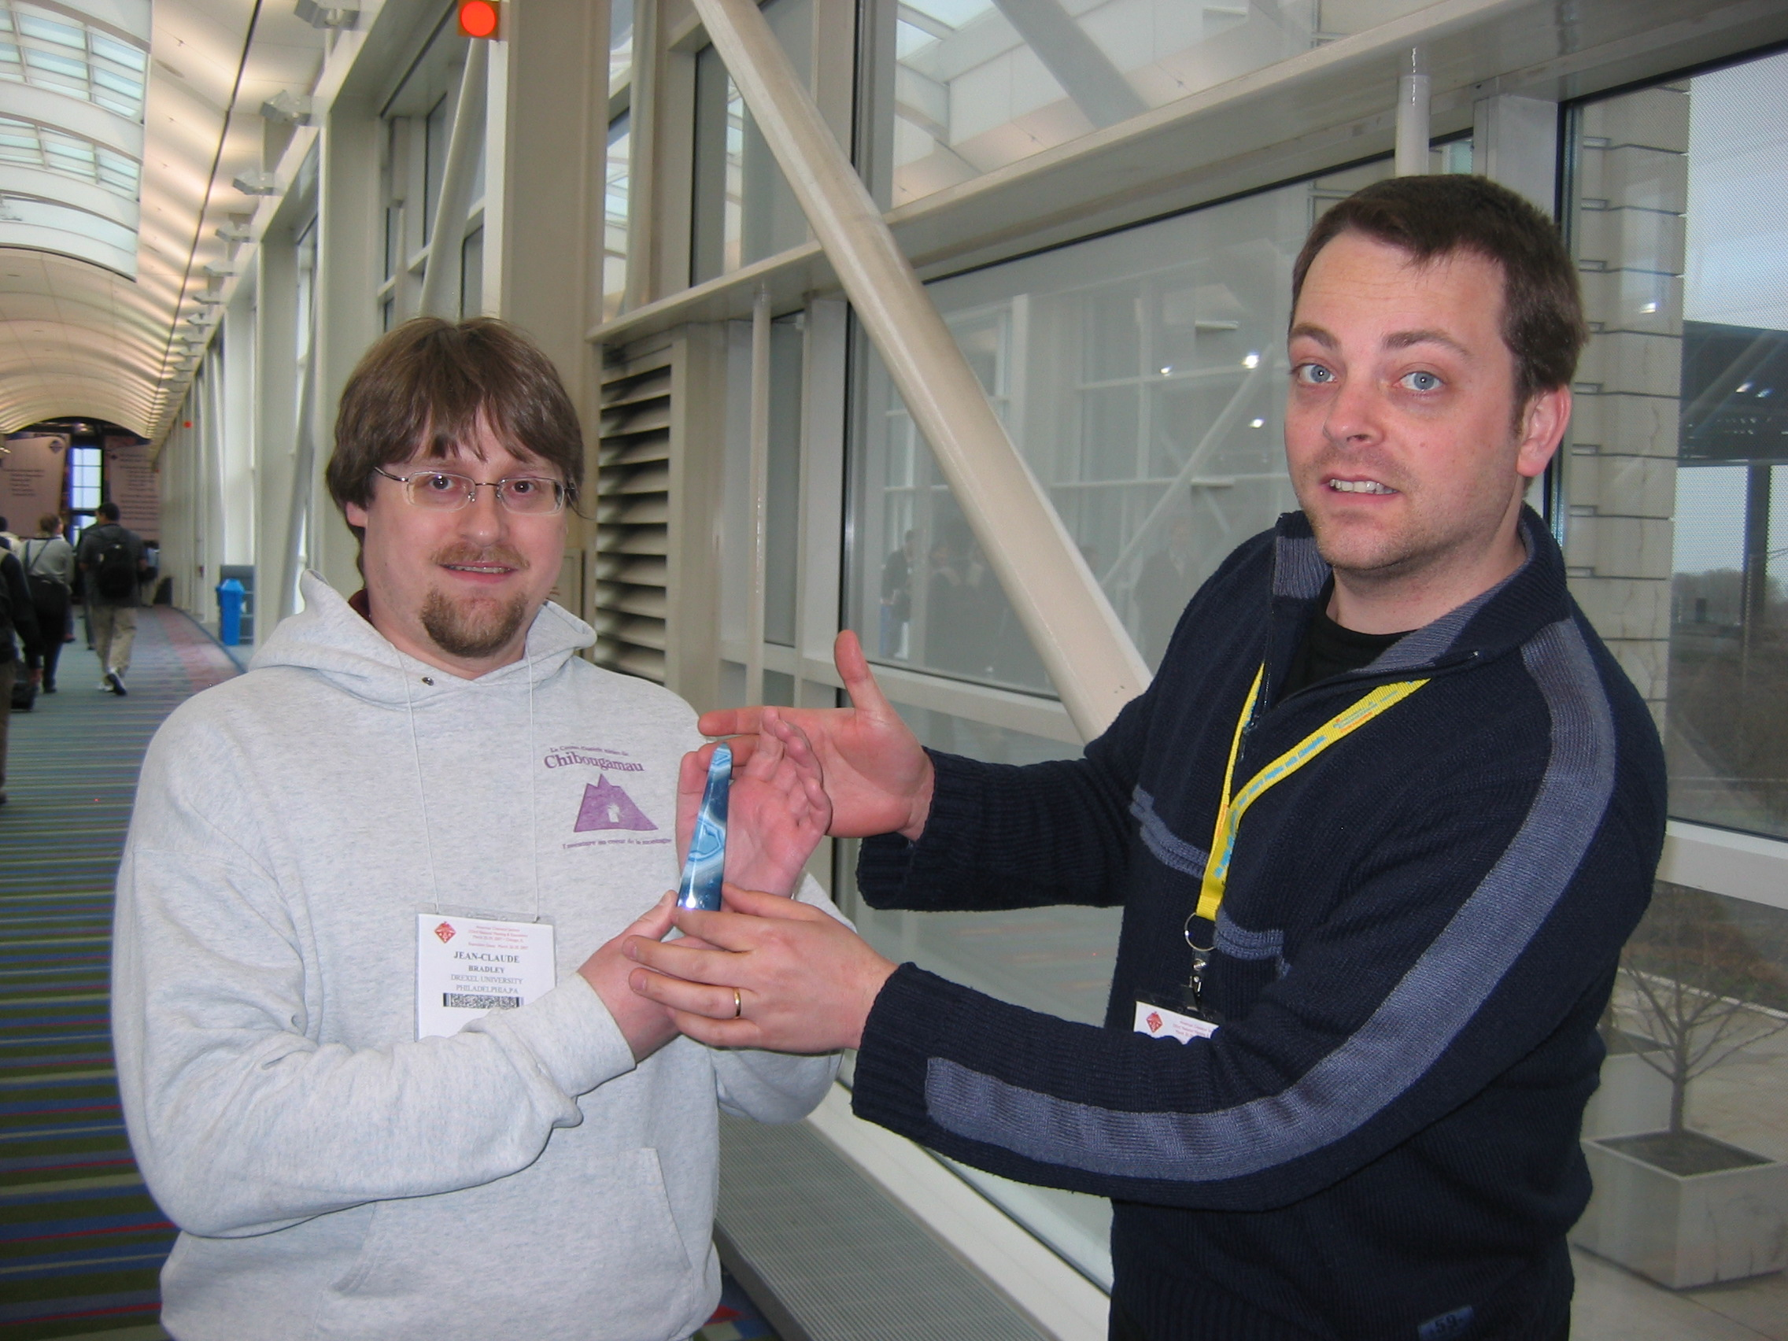
Award of Blue Obelisk
Jean-Claude Bradley
Egon Willighagen

Slide 6
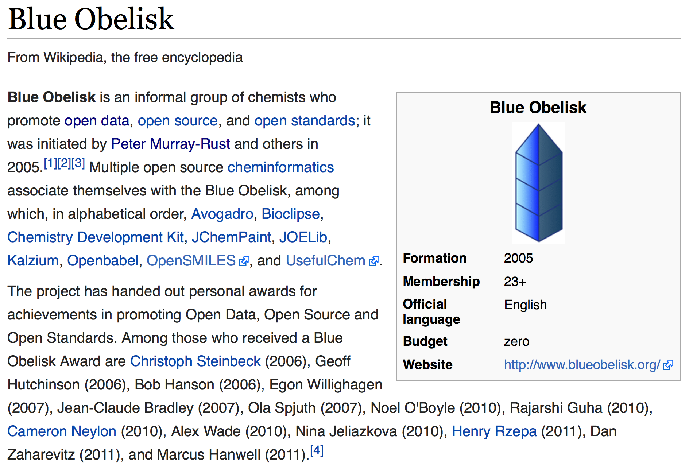

Slide 7
Conventional Research
DATA
???
rewrite
“Lab” work
Write
paper/thesis
publish
All your data are
belong to publisher
Validation??
Re-experiment

Slide 8
Free/Open Software Development
validate
Engineered repository
CODE
rewrite
fork
CODE
Re-use
inspires
Re-use
CODE
CODE
OSI
World
community
Github, BitBucket
Stackoverflow,
Apache
e.g. Chem4Word (M-R group)
Outercurve repository,
Now developed by ex-pharma s/w
And interfaced to ChemDoodle

Slide 9
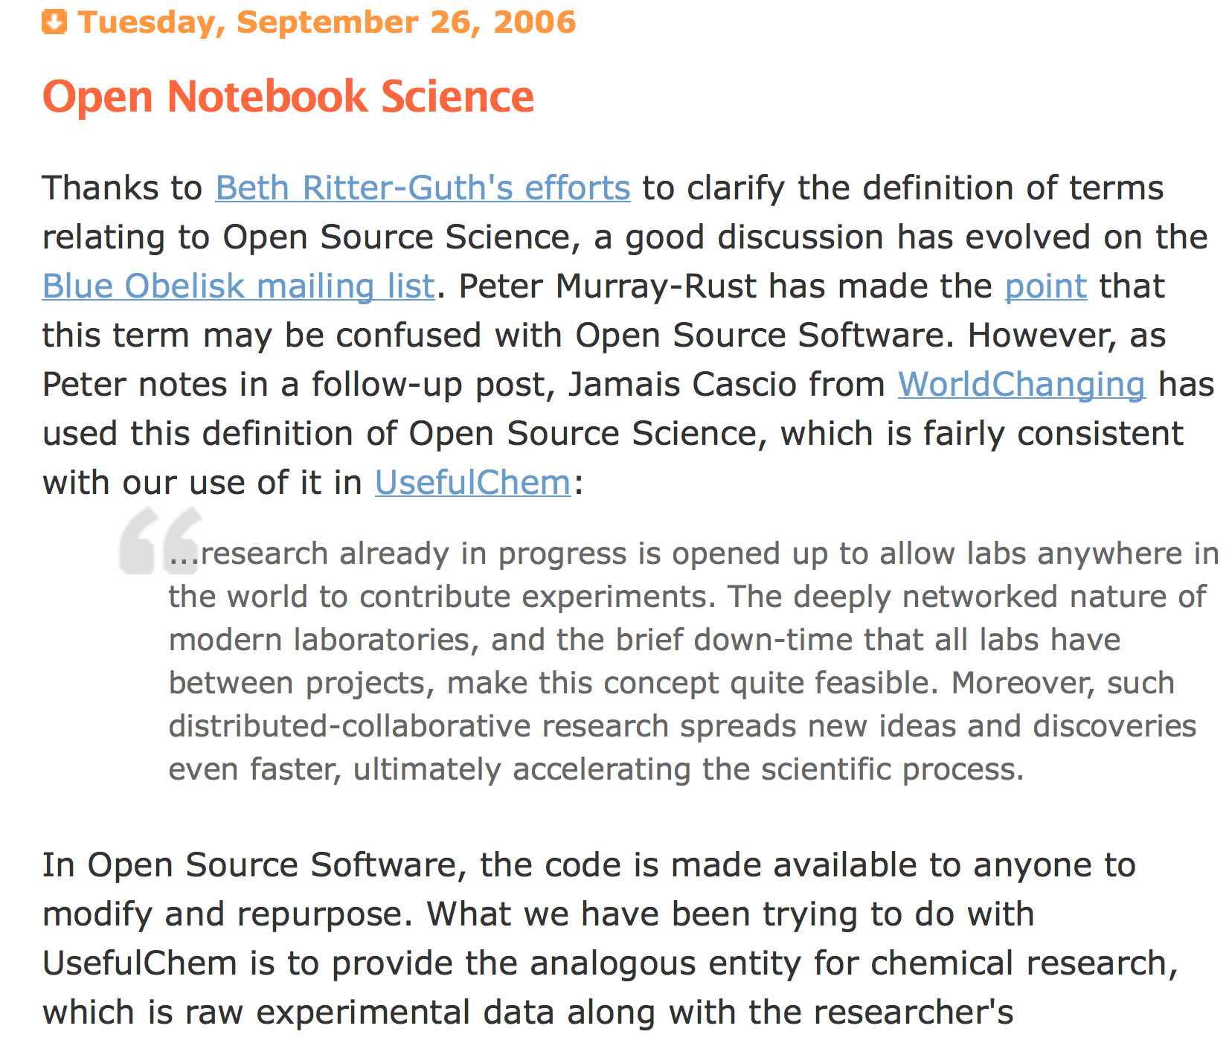

Slide 10
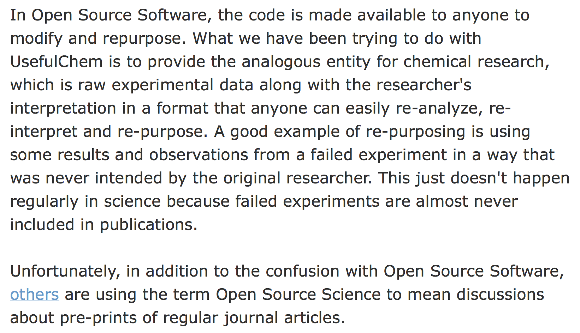
Open Source software inspires Open Science
Jean-Claude Bradley 2006

Slide 11
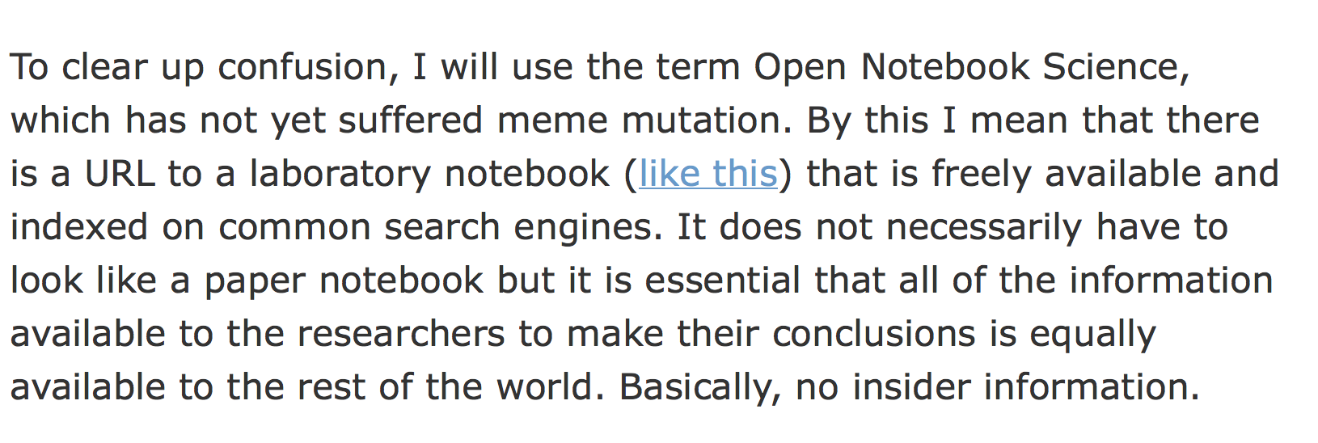
Open Notebook Science, ONS
Jean-Claude Bradley 2006

Slide 12
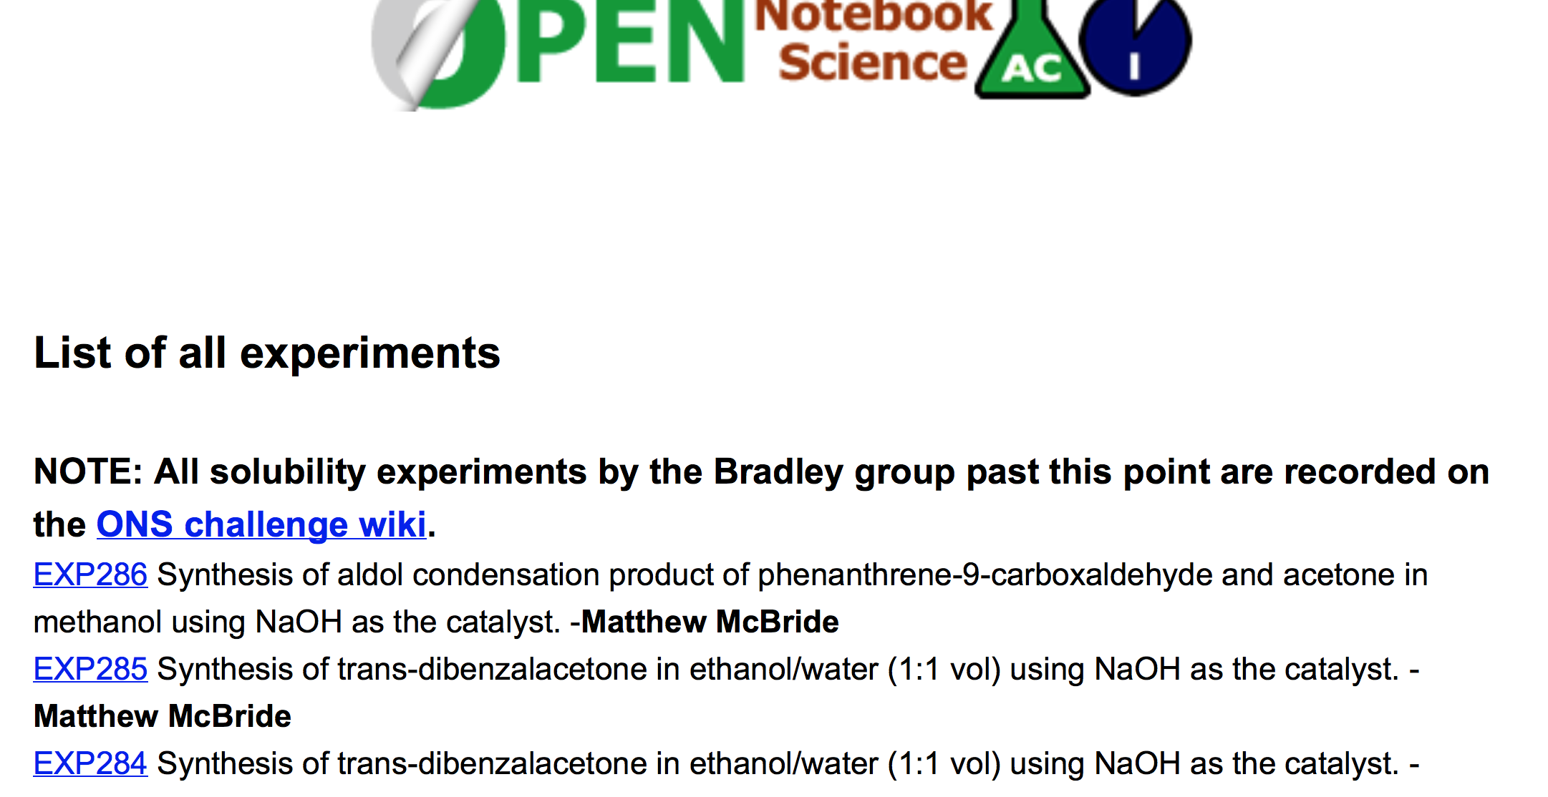

Slide 13
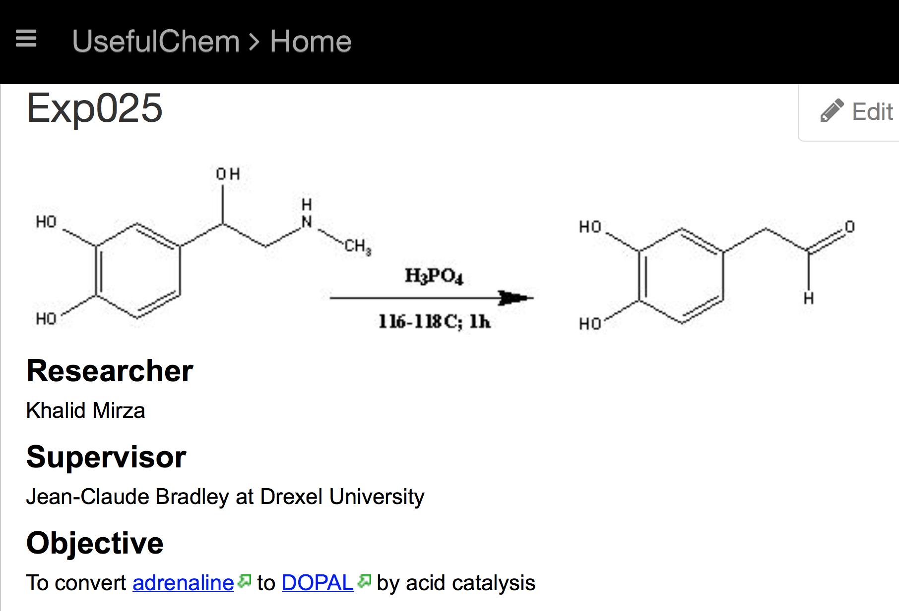
Jean-Claude Bradley 2006

Slide 14
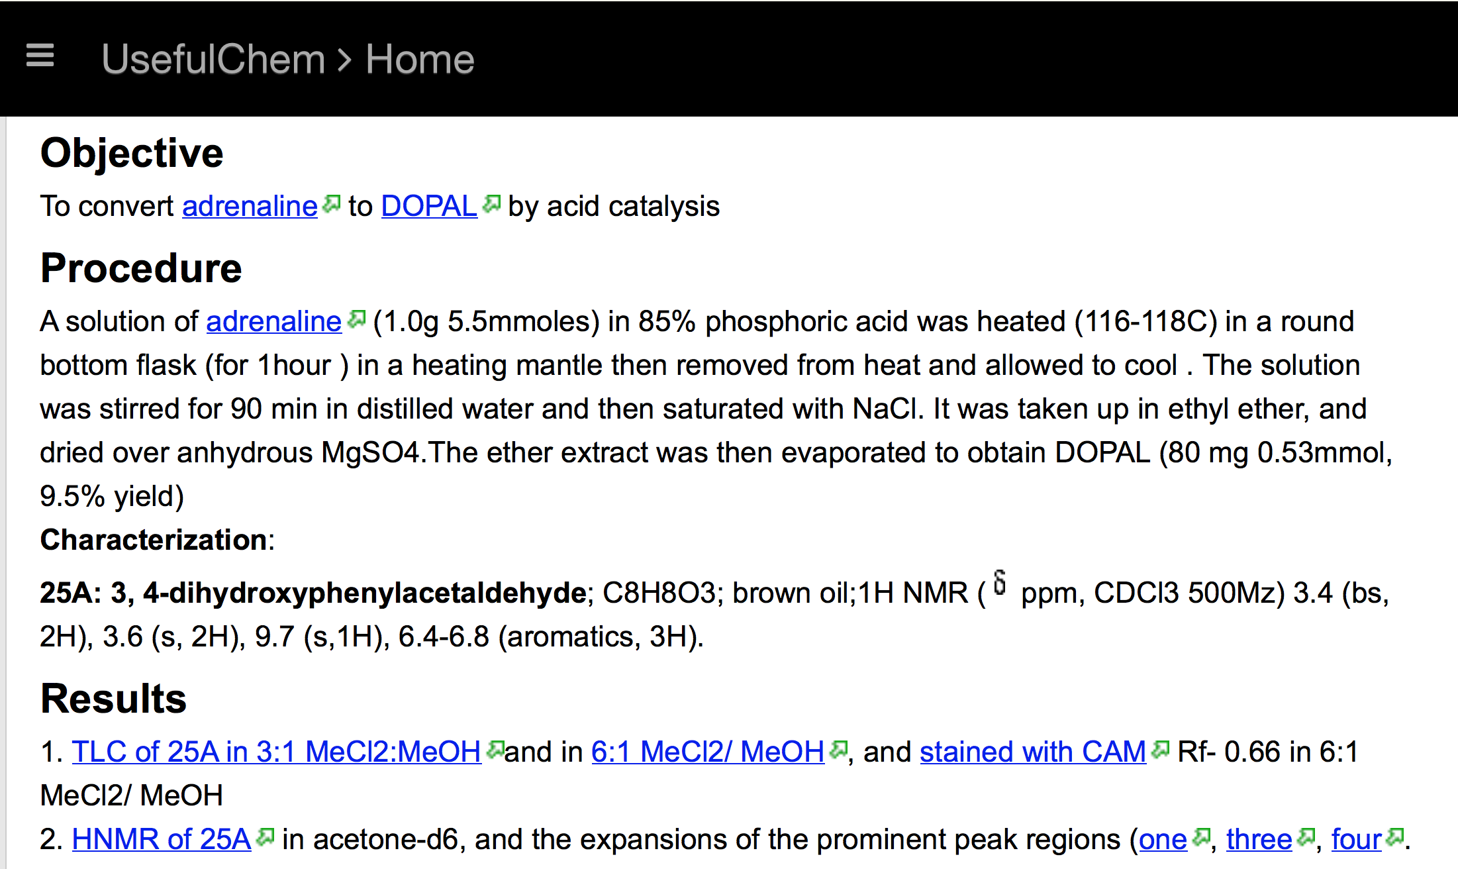
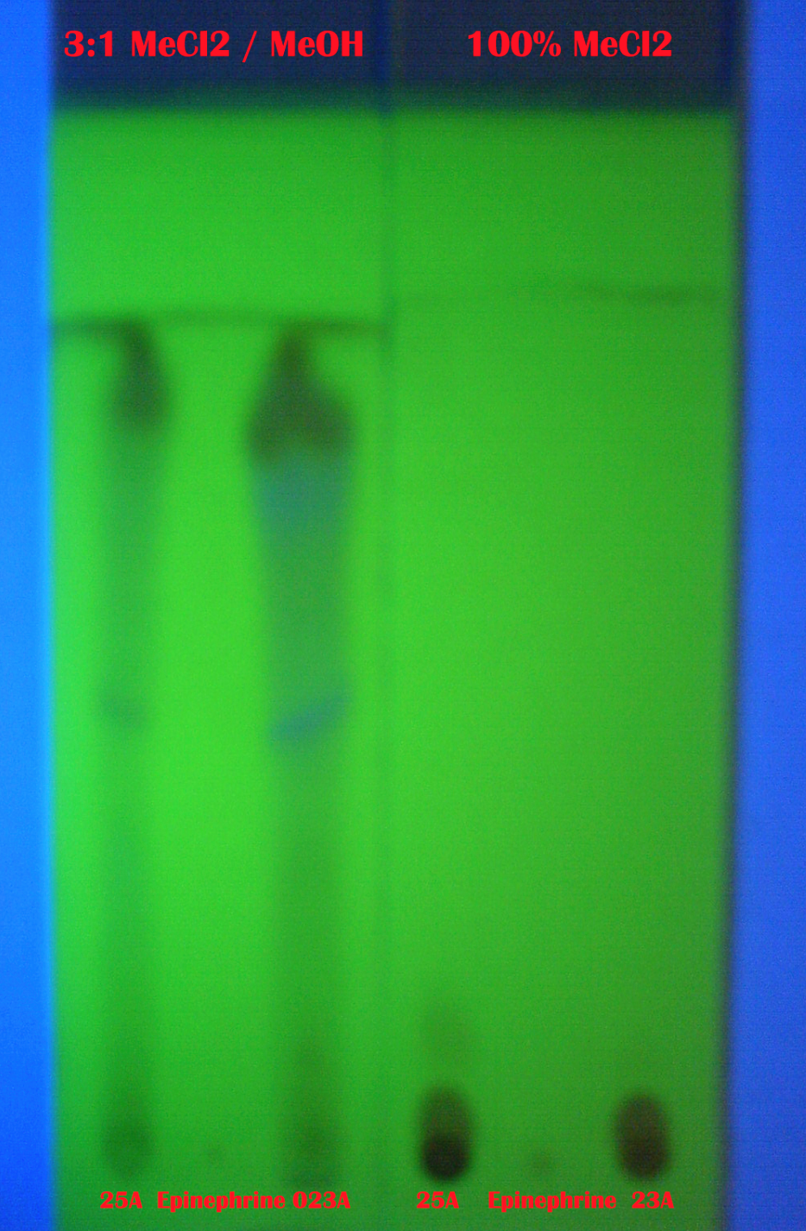
Jean-Claude Bradley 2006

Slide 15
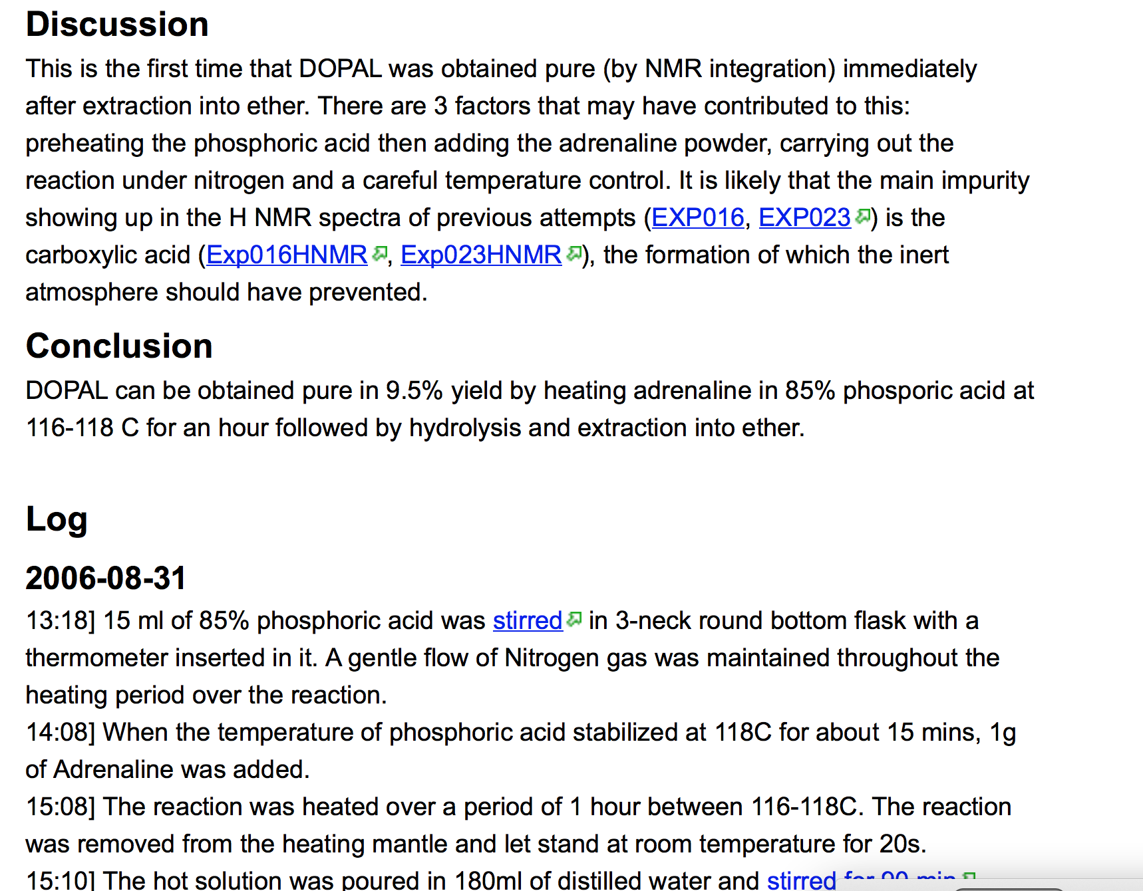
Jean-Claude Bradley 2006

Slide 16
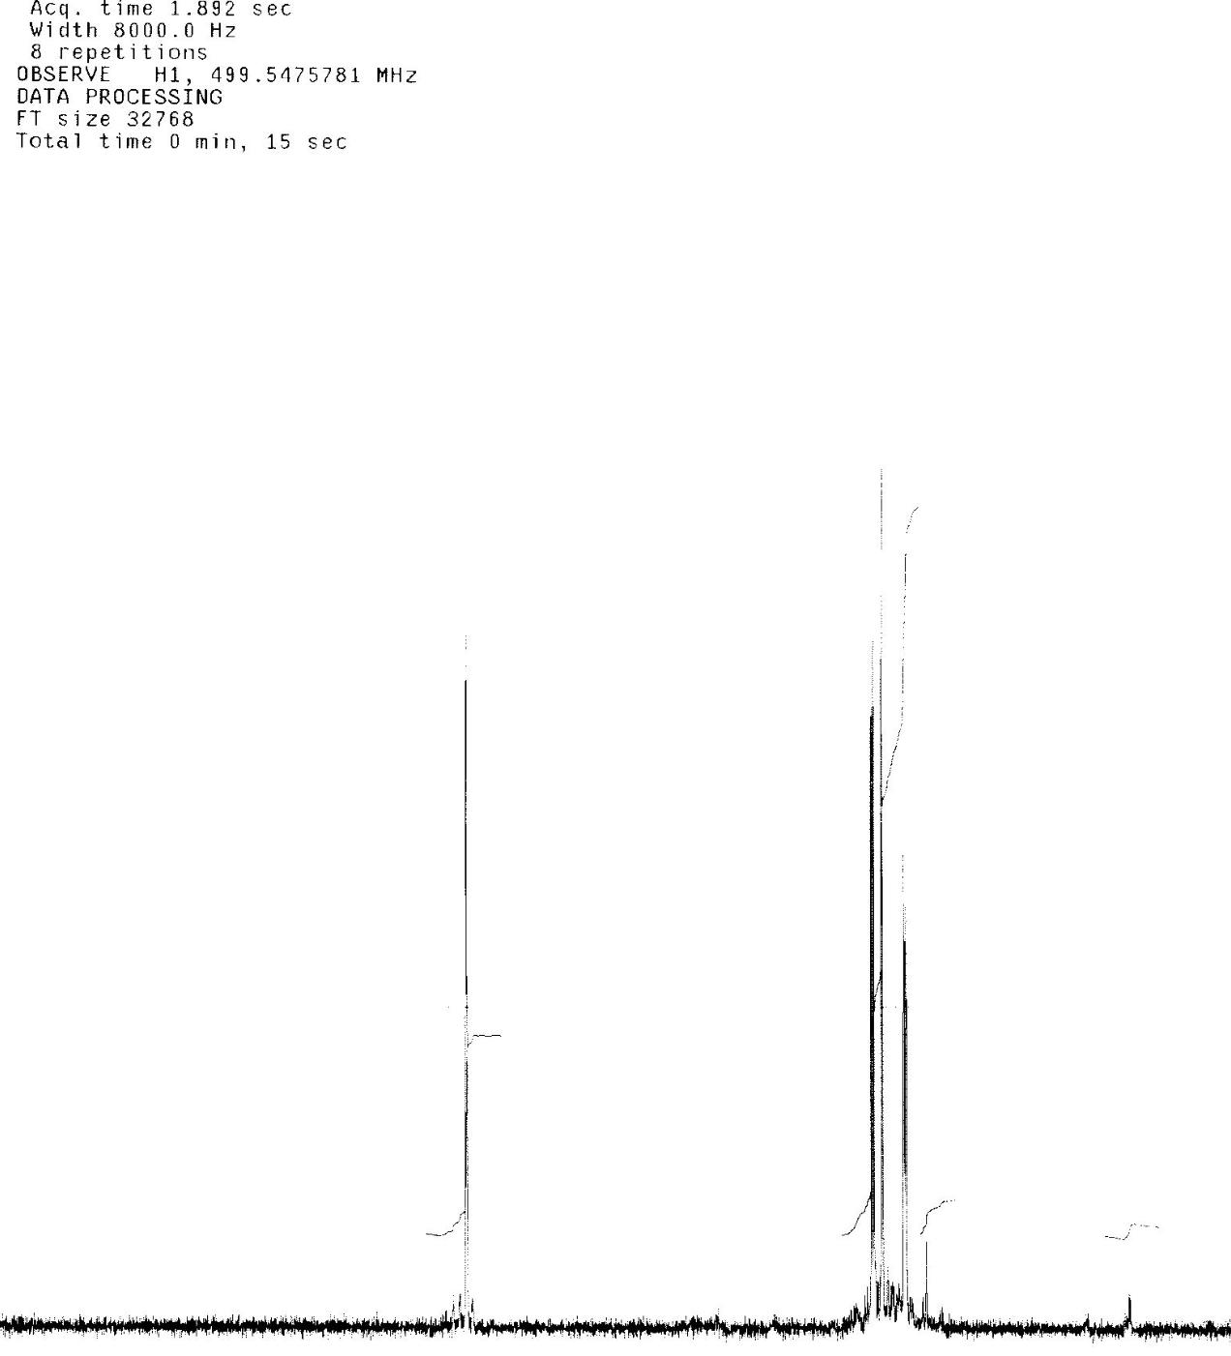
Jean-Claude Bradley 2006
And spectra were included as well

Slide 17
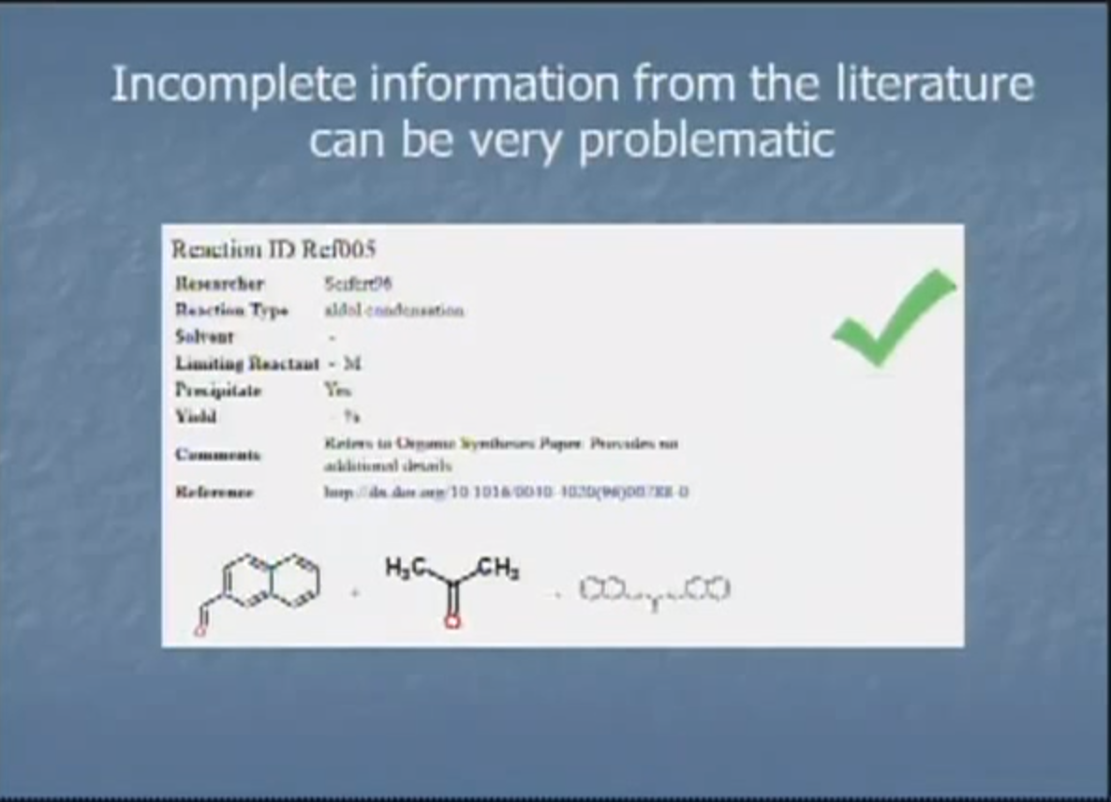
Jean-Claude Bradley talking in 2013
https://www.youtube.com/watch?v=BN8UjULNG9A&feature=youtube_gdata

Slide 18
Open Science
TOOLS
Open engineered
repository
validate
DATA
INSTRUMENT
merge
knowledge
DATA
calibrate
MODEL
CODE
Machines and humans
Working together
World
community
Problems are solved communally;
Nothing is needlessly duplicated; “publication“ is continuous ; data are SEMANTIC

Slide 19
Mat Todd, University of Sydney
JC was a pioneer in open science, and uncompromising about its importance. We had so many productive interactions over the years, starting from the end of January 2006, when we started our open chemistry project on The Synaptic Leap (JC was the first to comment!) and JC posted his very first experiment online at Usefulchem. I remember starting to think about how to do completely open projects, looking around the web in 2005 to see if anything open was going on in chemistry, and coming across JC's lone voice, and I thought "Wow, who is this guy?" He had dedication and integrity - we'll all miss him.
2014-05-15 (Mail to PM-R)

Slide 20
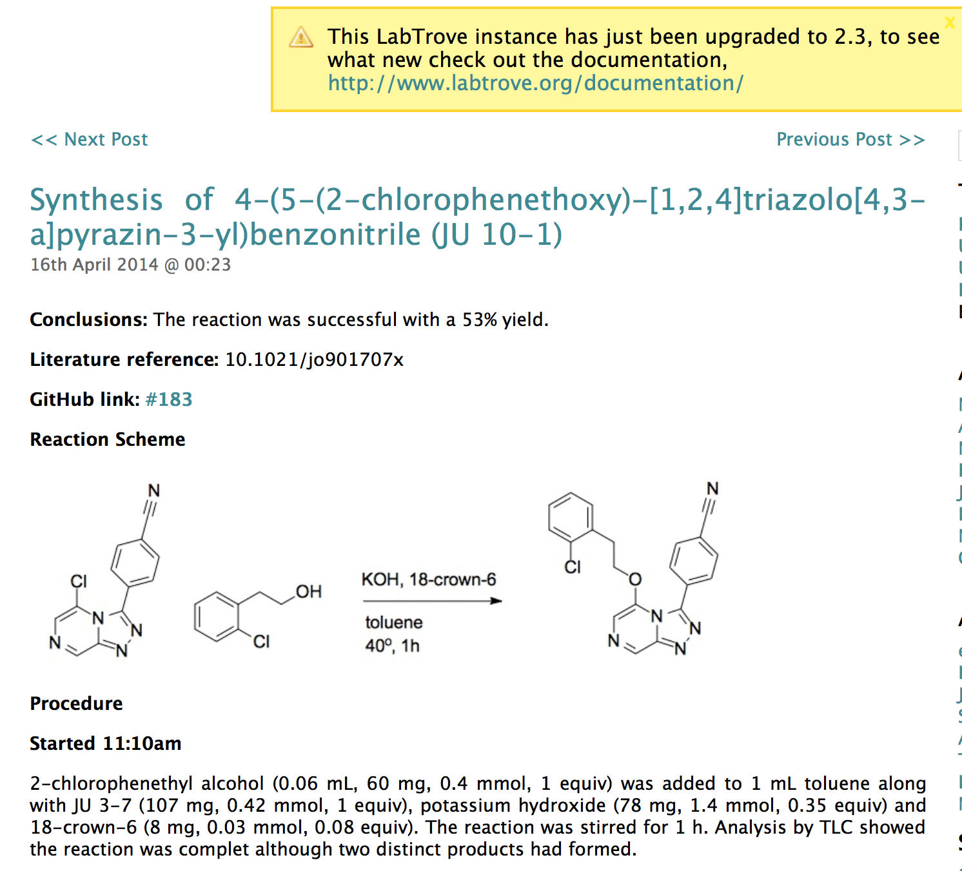
Mat Todd, University of Sydney: Antimalarial

Slide 21
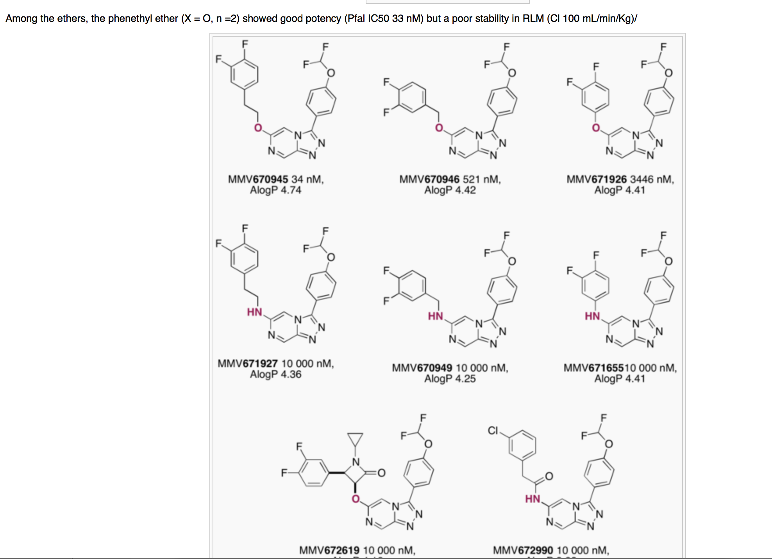

Slide 22
The economic value of data
I believe that we spend globally ca 400 billion USD / yr on public research.
The outputs include:
Knowledge / papers / patents
Organizations
People
materials
Data – many billions/year and much is lost

Slide 23
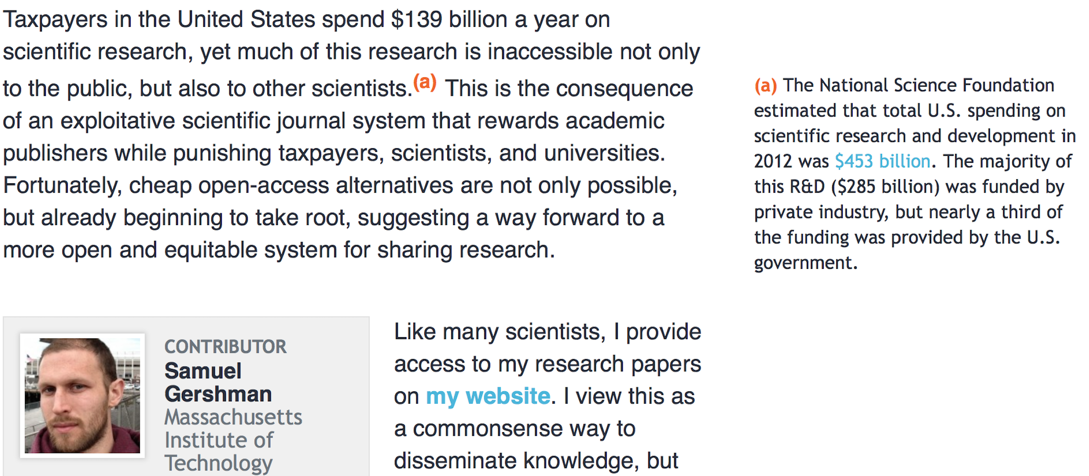

Slide 24
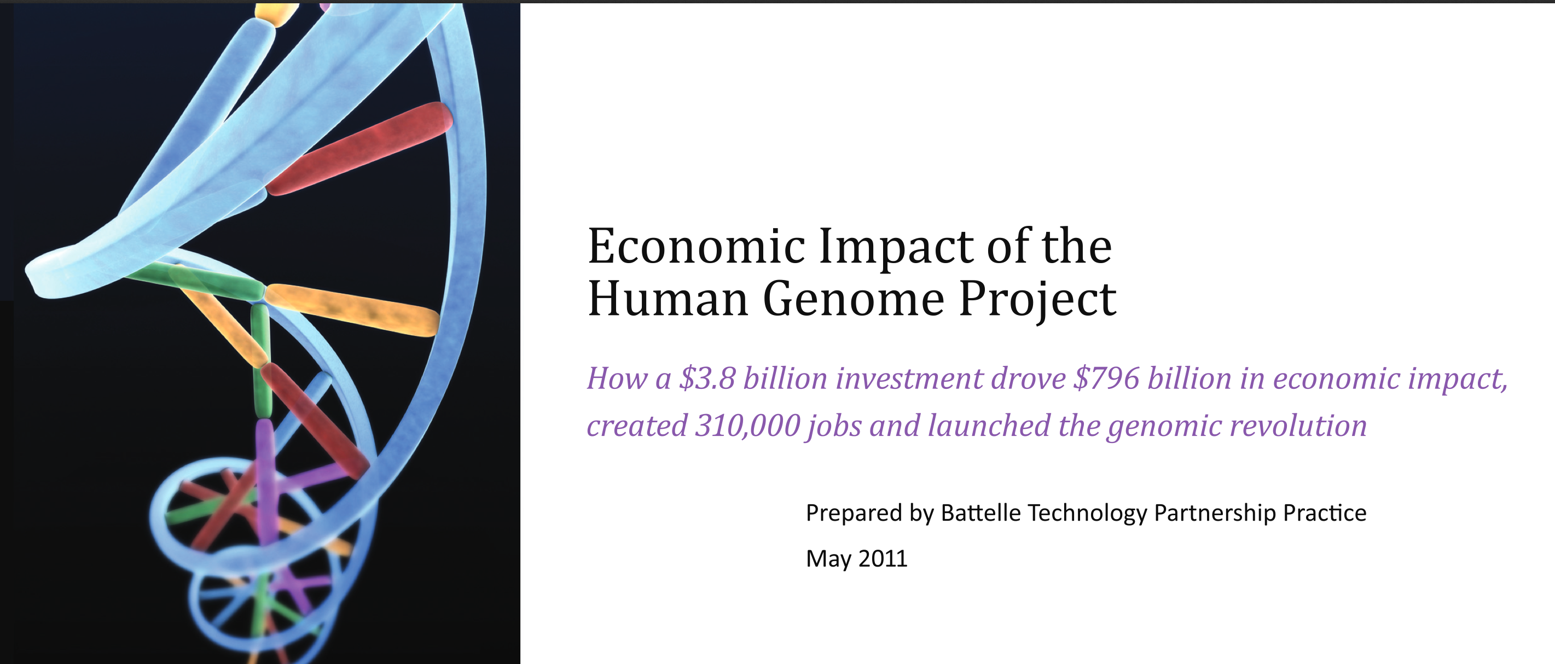

Slide 25
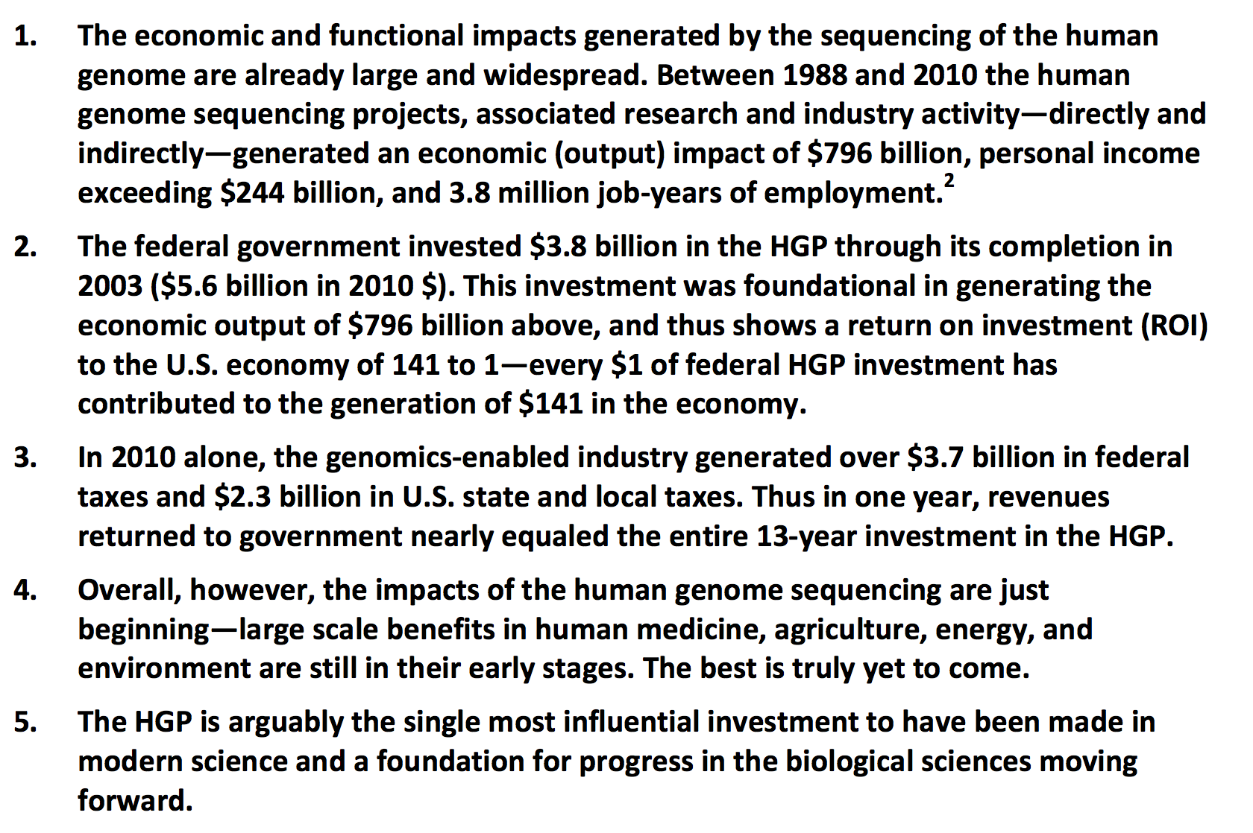

Slide 26
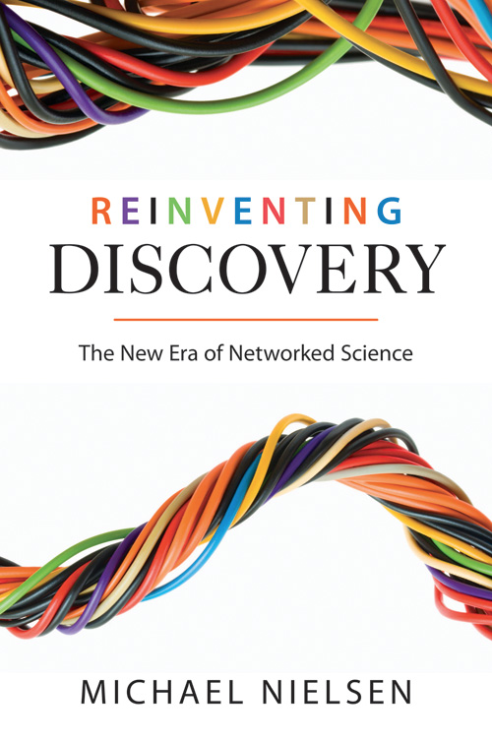

http://michaelnielsen.org/blog/reinventing-discovery/

Slide 27
https://en.wikipedia.org/wiki/Reinventing_Discovery
Michael Neilsen
Kasparov versus the World, The Wisdom of Crowds, various online collaborative projects
InnoCentive, collective intelligence, Paul Seabright's economic theory, online chat
History of Linux, Open Architecture Network, Wikipedia, MathWorks' computer programming contest
communication in small groups, particularly as studied by Stasser and Titus; praxis of science; a discussion of communication among scientists
Don R. Swanson and Literature-based discovery, predicting influenza with Google searches, Sloan Digital Sky Survey, Allen Institute for Brain Science, Ocean Observatories Initiative, Human Genome Project, Google Translate
Democratizing Science Galaxy Zoo, Foldit, citizen science, eBird, open access, arXiv, PLoS
The Challenge of Doing Science in the Open Complexity Zoo, academic publishing
The Open Science Imperative Open science, academic journal publishing reform, SPIRES
appendix - The problem solved by the Polymath Project

Slide 28
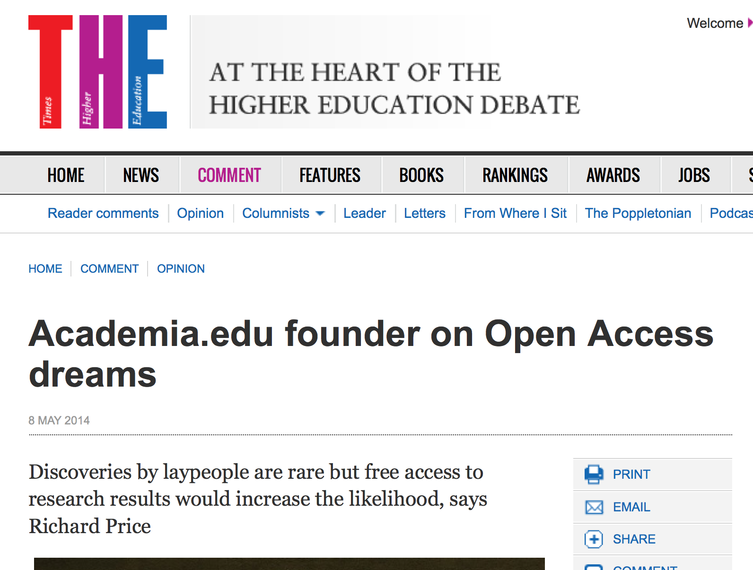

Slide 29
“Free” and “Open”
"Free software is a matter of liberty, not price. ’free speech', not 'free beer'”. (RMS)
“A piece of data or content is open if anyone is free to use, reuse, and redistribute it” (OKFN)http://opendefinition.org/
“open” (access) has multiple incompatible “definitions”. Major split is “human eyeballs” vs copying and machine “reusability”
“Open” is a marketing term for publishers, who frequently (often deliberately) do not grant full Openness.

Slide 30
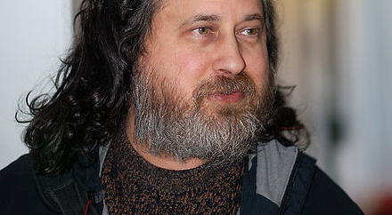
4 Freedoms (Richard Stallman)
Freedom 0: The freedom to run the program for any purpose.
Freedom 1: The freedom to study how the program works, and change it to make it do what you wish.
Freedom 2: The freedom to redistribute copies so you can help your neighbor.
Freedom 3: The freedom to improve the program, and release your improvements (and modified versions in general) to the public, so that the whole community benefits.
"I’ve spent a third of my life building software based on Stallman’sfour freedoms, and I’ve been astonished by the results. WordPress wouldn’t be here if it weren’t for those freedoms, and it couldn’t have evolved the way it has.”
- Matt Mullenweg, co-creator of WordPress

Slide 31
Critical Historical Open Events
Free Software Foundation (RMS, 1985) and Linux (Torvalds, 1991)
The World Wide Web (TBL, 1991)
The human genome (1990-2001)
The life of Aaron Swarz (1986-2013)

Slide 32
https://en.wikipedia.org/wiki/Bermuda_Principles
Automatic release of sequence assemblies larger than 1 kb (preferably within 24 hours).
Immediate publication of finished annotated sequences.
Aim to make the entire sequence freely available in the public domain for both research and development in order to maximise benefits to society.

Slide 33
http://www.budapestopenaccessinitiative.org/read
… an unprecedented public good. …
… completely free and unrestricted access to [peer-reviewed literature] by all scientists, scholars, teachers, students, and other curious minds. …
…Removing access barriers to this literature will accelerate research, enrich education, share the learning of the rich with the poor and the poor with the rich, make this literature as useful as it can be, and lay the foundation for uniting humanity in a common intellectual conversation and quest for knowledge.
(BOAI, 2003)

Slide 34
Where to put the data?

Slide 35
Mendeley From Wikipedia, the free encyclopedia
Mendeley – a social media site used by many scientists to store metadata …
… purchased by Elsevier in 2013
David Dobbs, in The New Yorker, described motive as:
to acquire its user data,
to destroy or coöpt an open-science icon that threatens its business model.
PM-R: Mendeley can also Snoop and Control

Slide 36
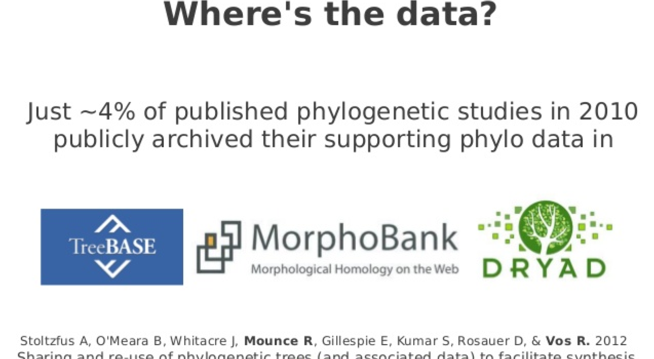
Authors don’t deposit data (Ross Mounce)

Slide 37
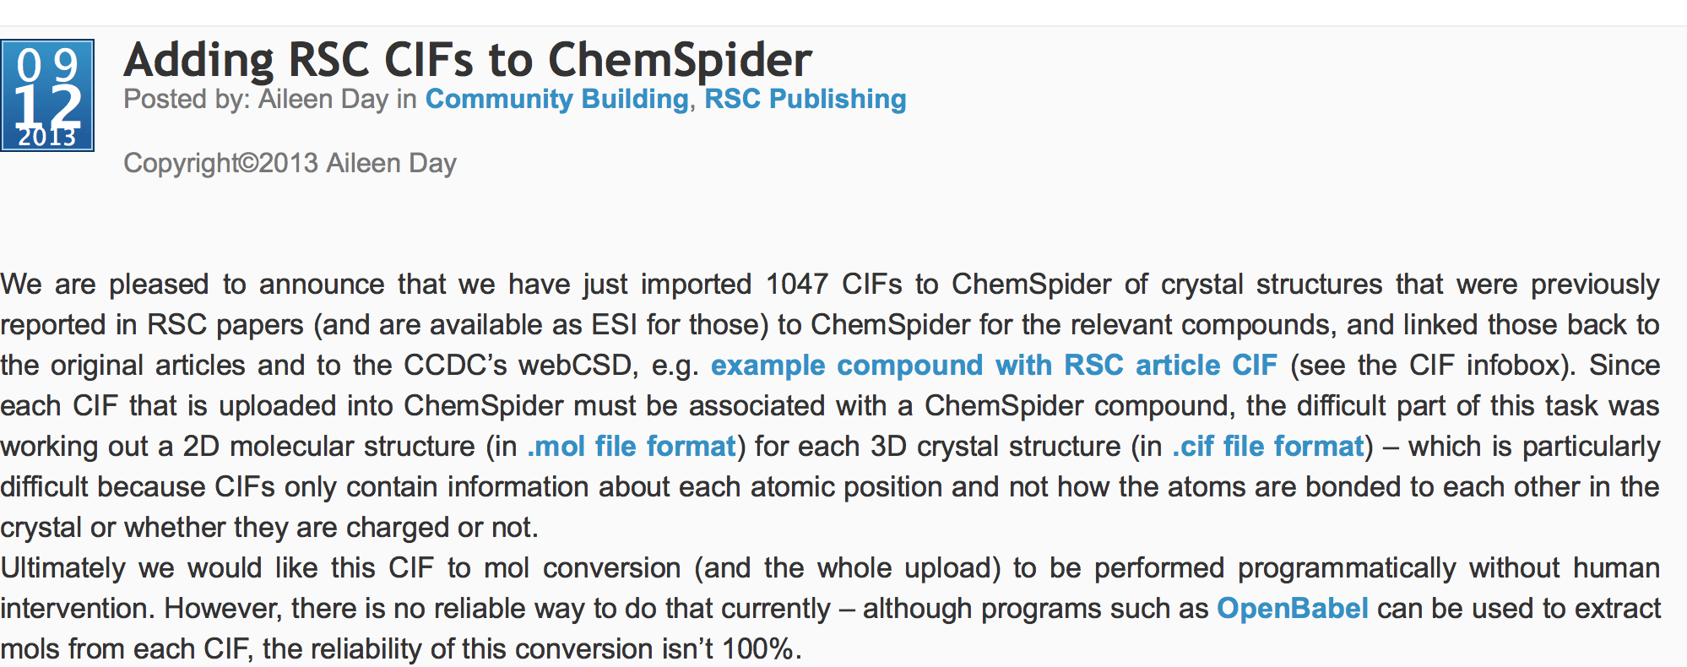
NOTE: RSC have always published raw crystal data as
“CC0” and the enhanced data is openly
available

Slide 38
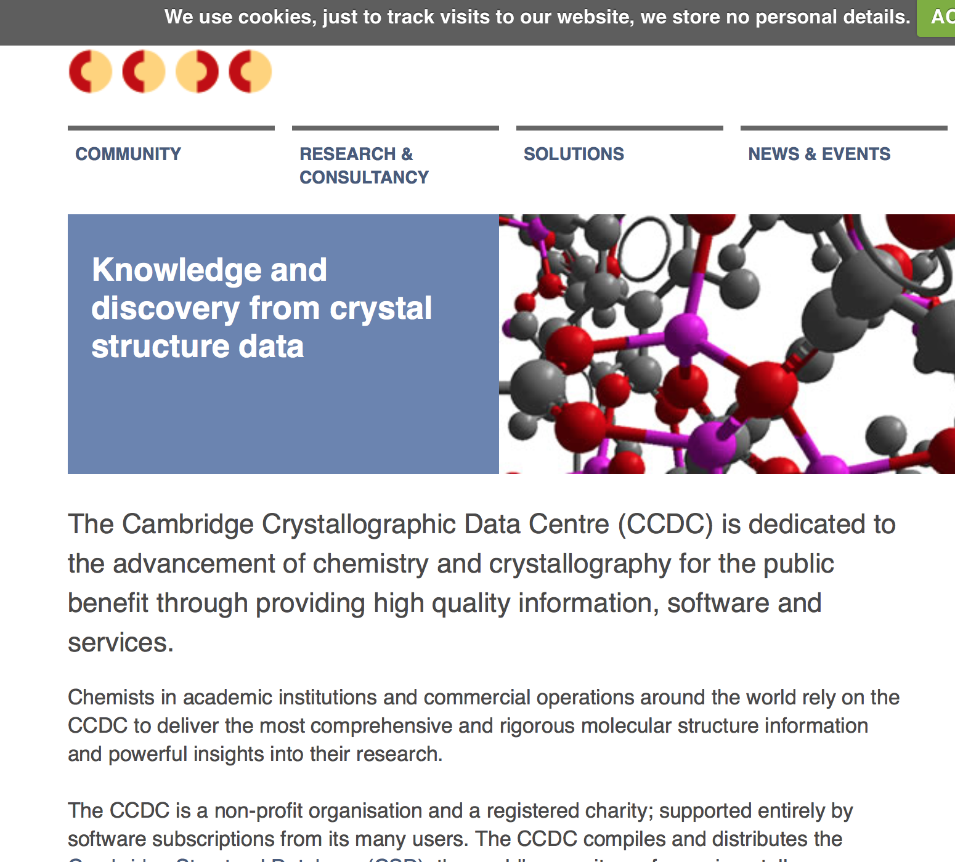

Slide 39
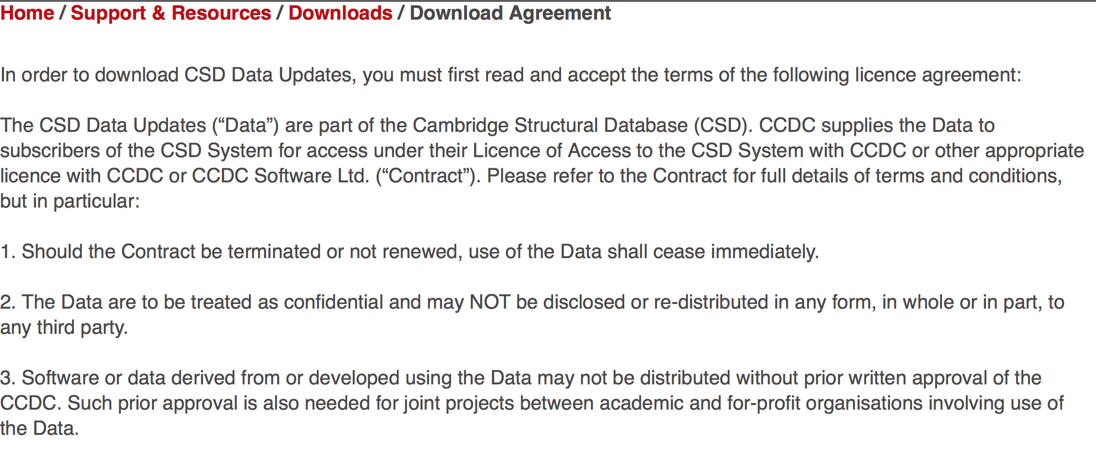
Restrictions on Re-use of Crystallographic data
NOTE: The CCDC is based on data contributed by
scientists as part of publication and validation

Slide 40
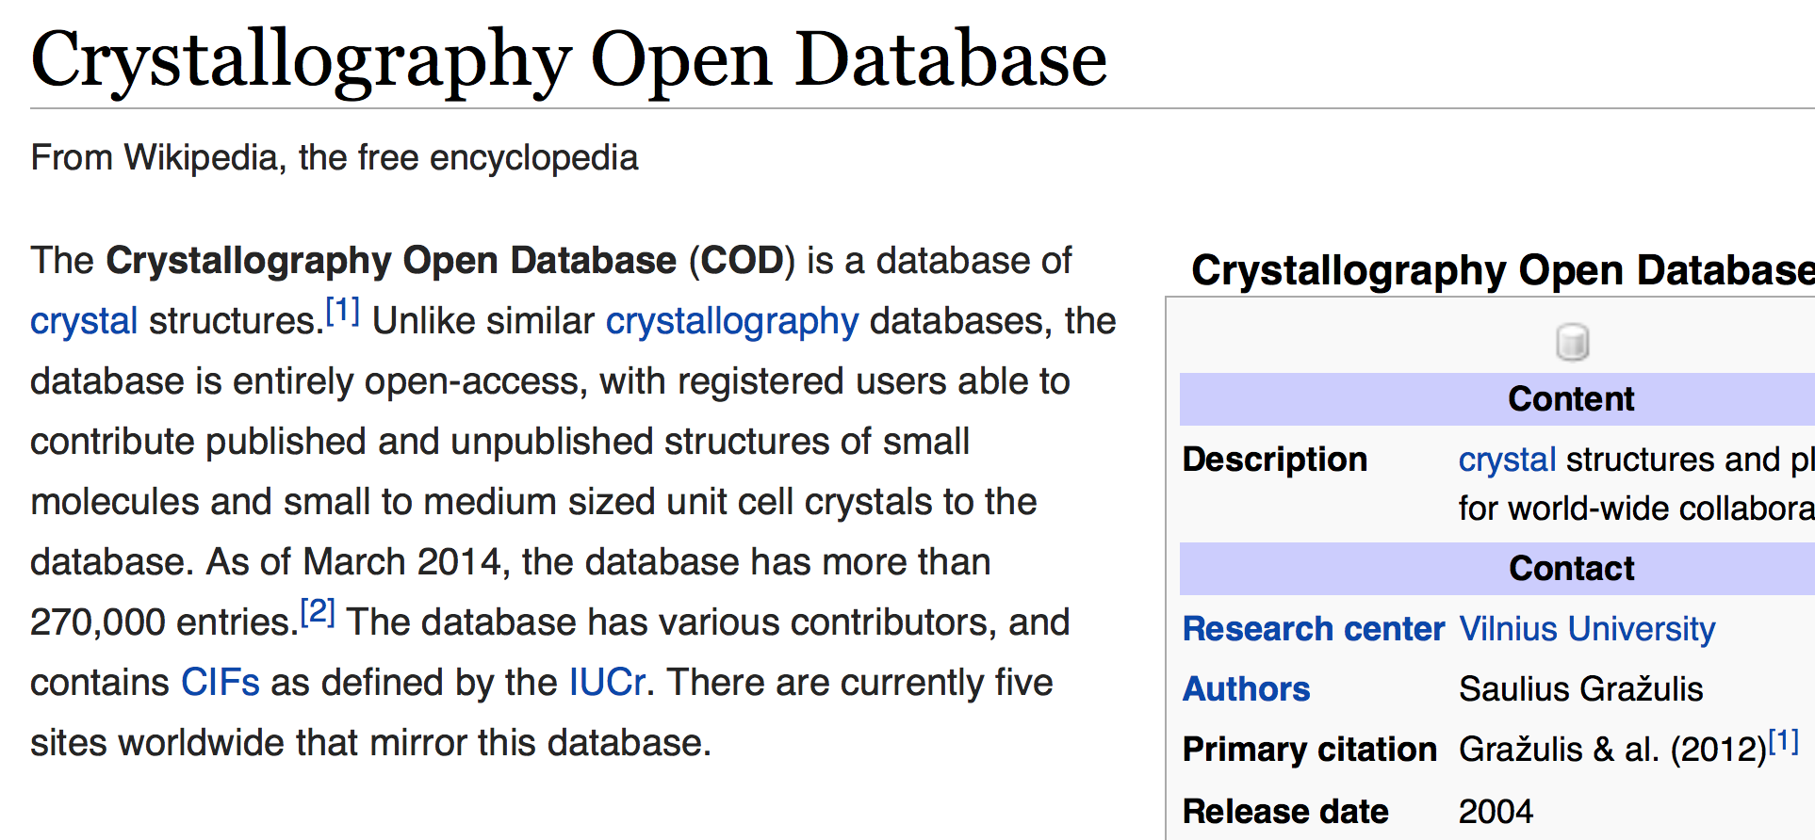
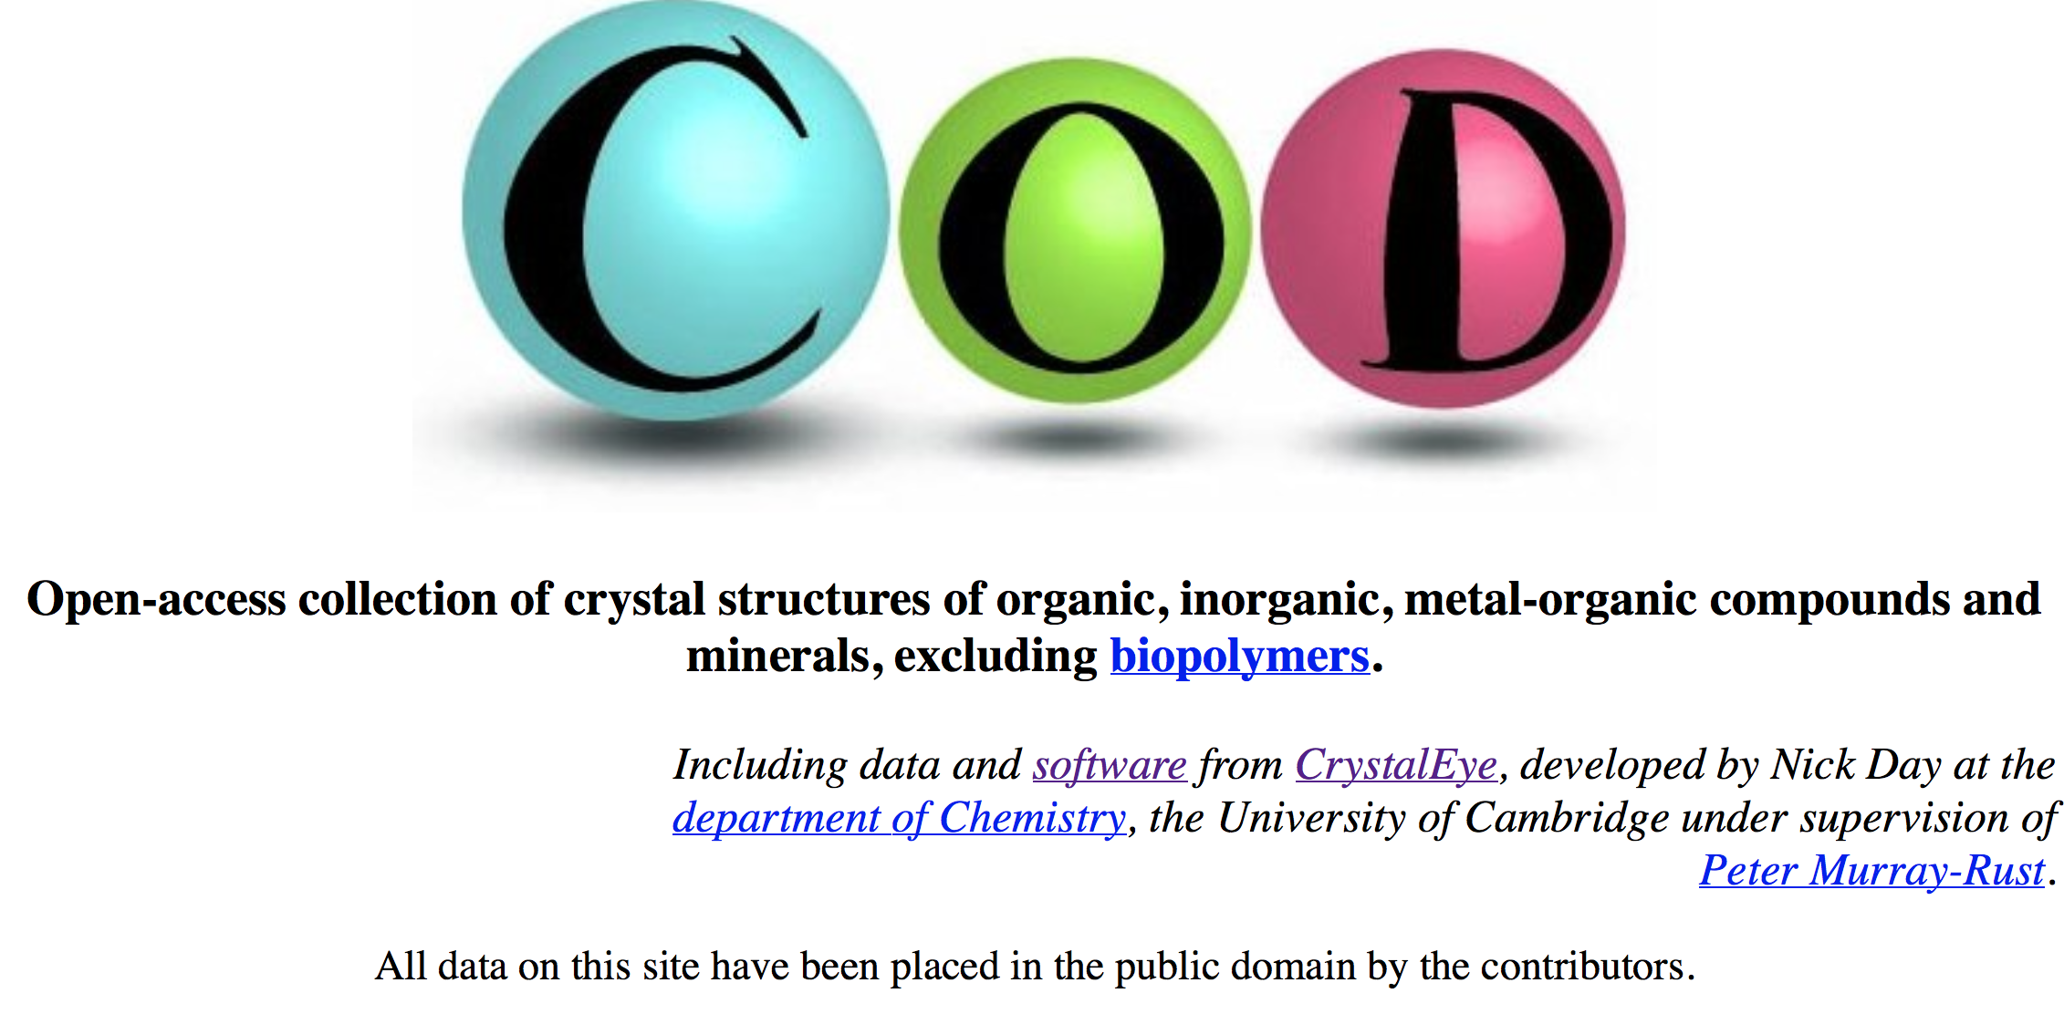

Slide 41
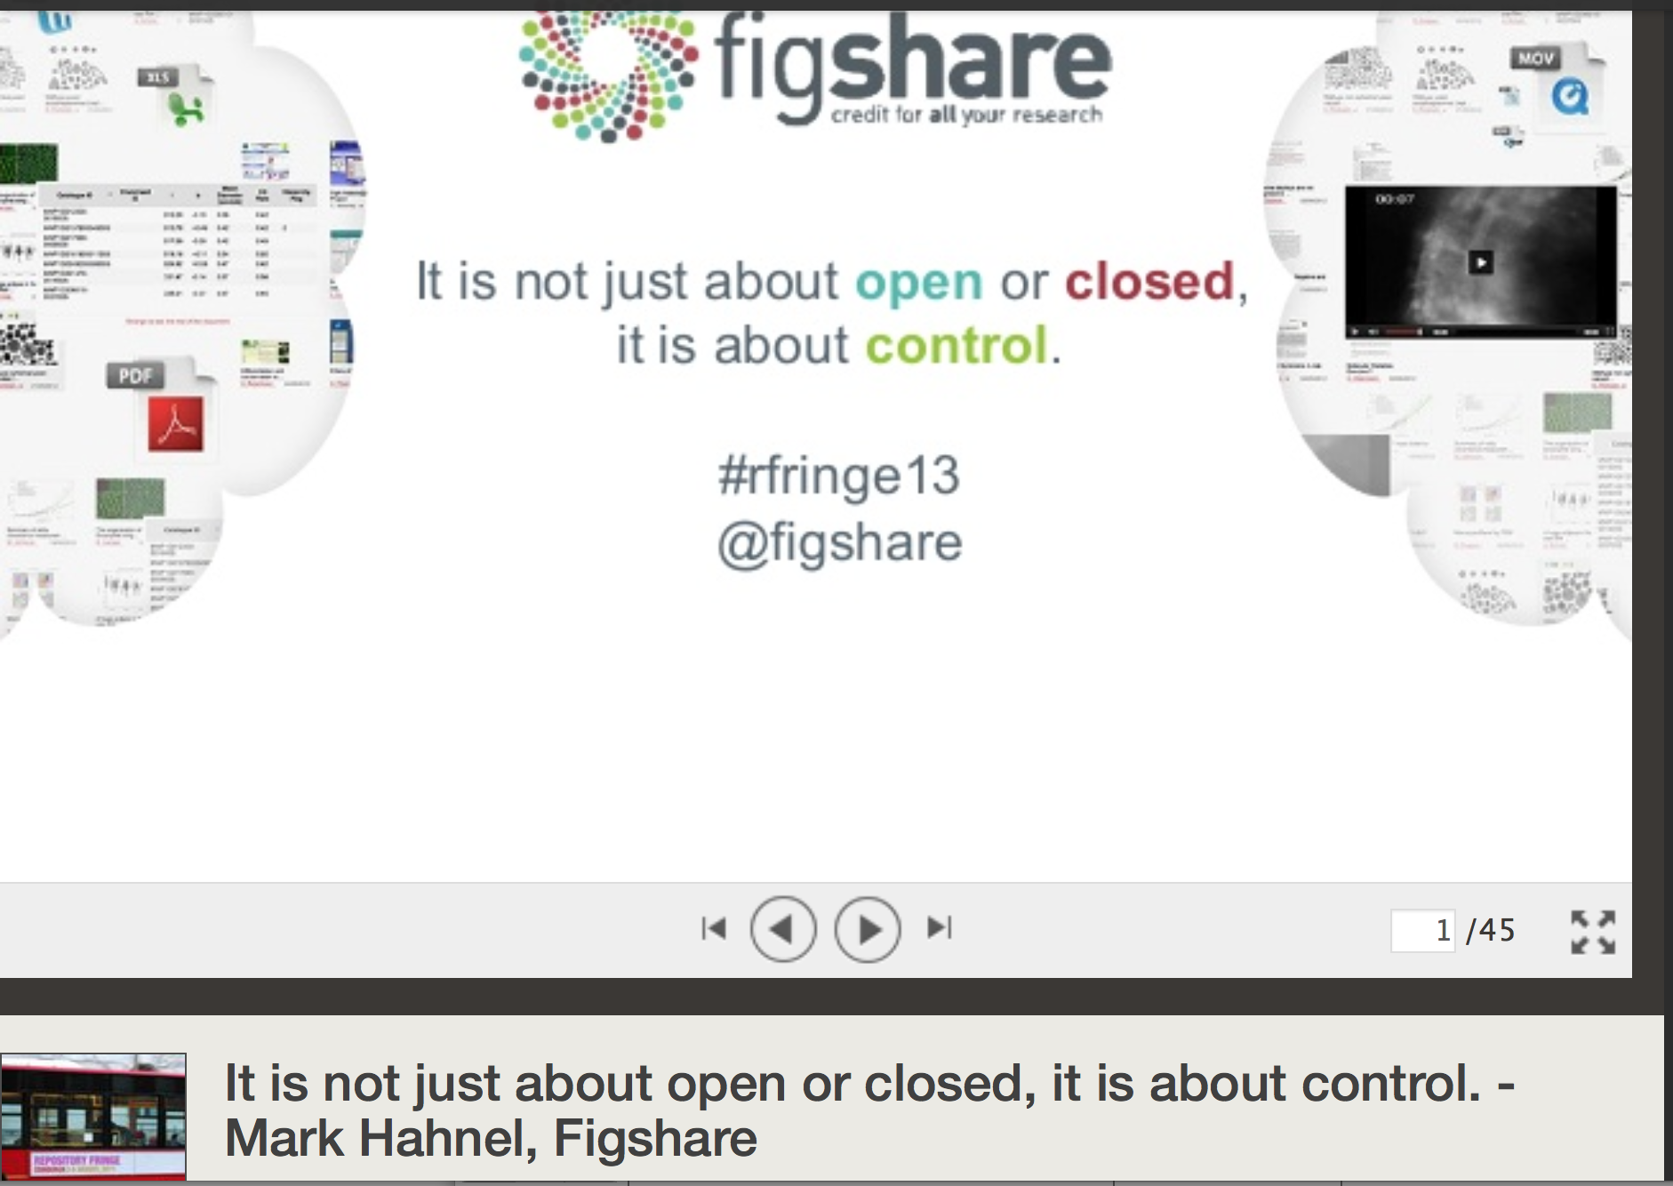

Slide 42
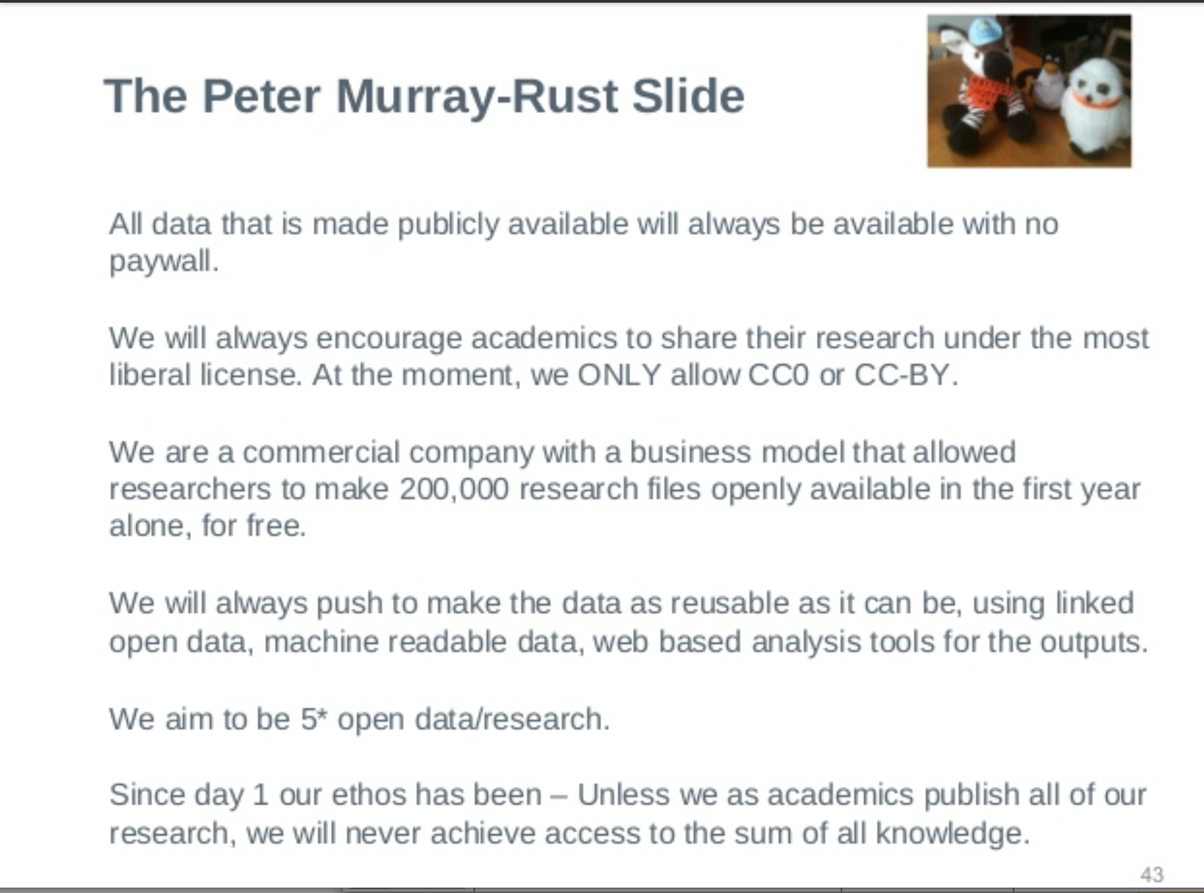
(auth: Mark Hahnel in response to our debates)

Slide 43
Panton Principles for Open Data in science(2010)
…make an explicit and robust statement of your wishes.
Use a recognized waiver or license that is appropriate for data.
open as defined by the Open Knowledge/Data Definition (… NOT non-commercial)
Explicit dedication of data … into the public domain via PDDL or CCZero

Slide 44
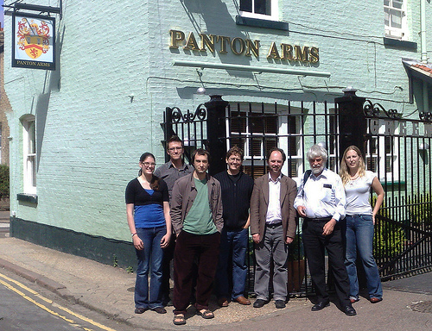
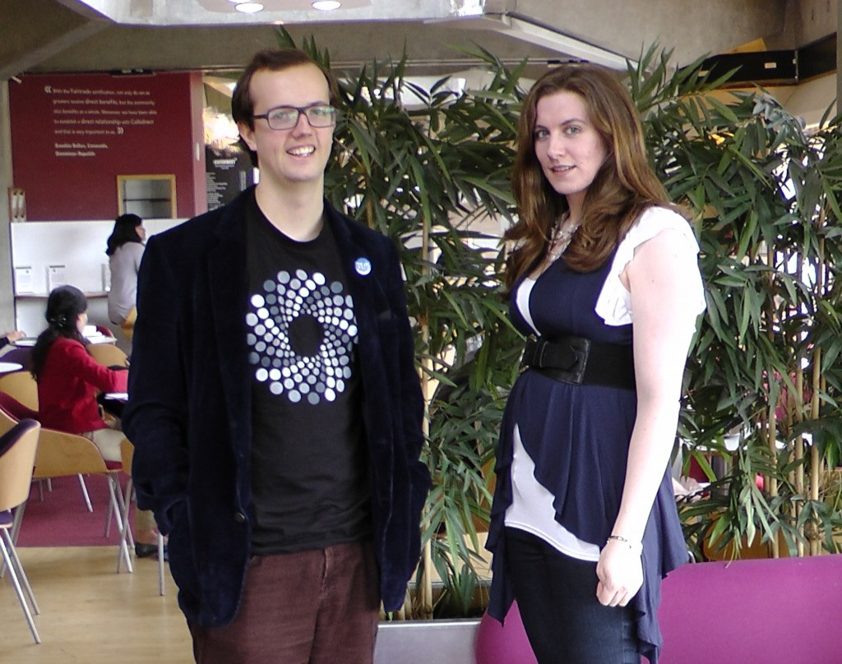
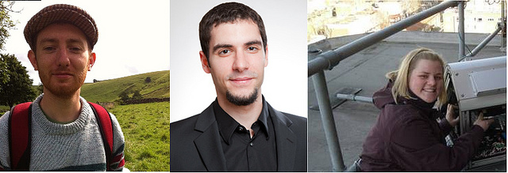
Panton Authors and Fellows

Slide 45
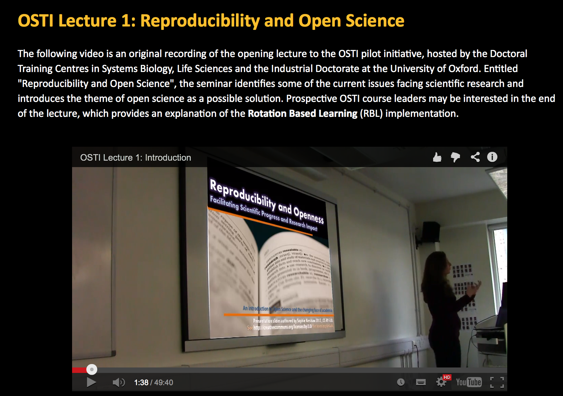
Sophie Kershaw, Panton Fellow :
Doctoral Training in Oxford

Slide 46
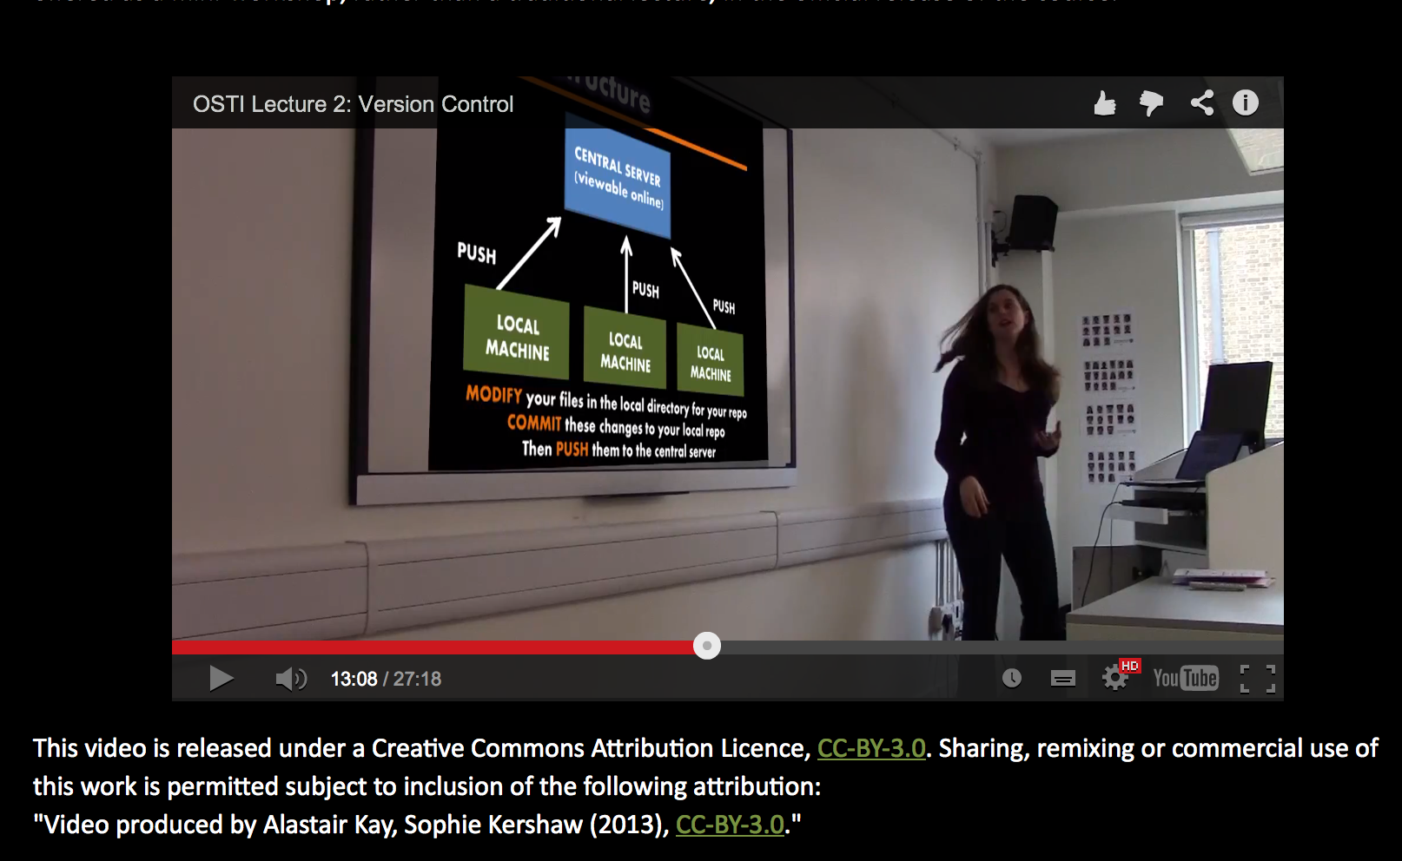
Sophie Kershaw, Panton Fellow

Slide 47

Reproducibility?
Begley & Ellis (2012)
Nature 483, 531-533
Image shown is from front page of Begley & Ellis (2012), produced by the Nature Publishing Group

Slide 48
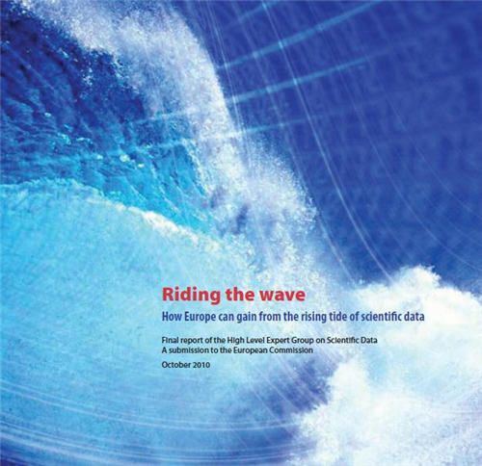
“Riding The Wave”
European Commission
October 2010
“Train a new generation of data scientists and broaden public understanding”

Slide 49
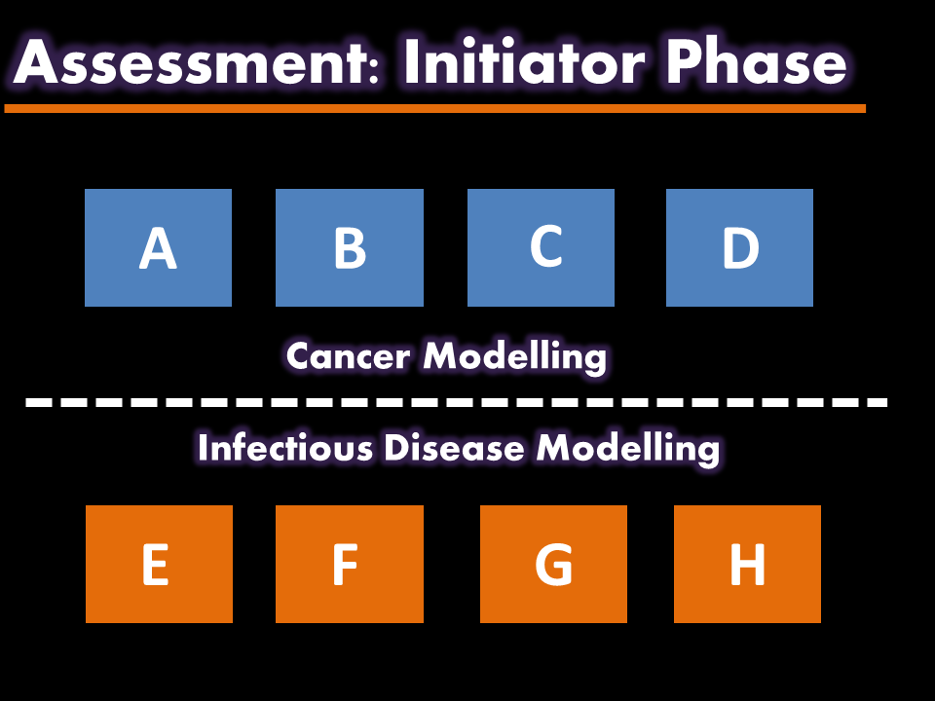
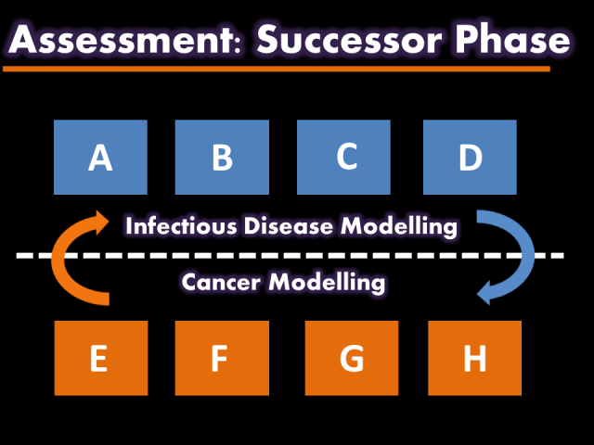
Rotation-Based Learning (RBL)
Role of research producer vs. research user
Can this approach help to foster awareness of reproducibility issues?
Phase 1: Initiator
No communication permitted between groups
Attempt to reproduce existing literature
Deliver a coherent research story by the end of Phase 1
Throughout Phases 1 & 2:
Daily lectures on open science culture & techniques
First-hand application to own research work
Version control using GitHub
Daily group supervision
Phase 2: Successor
Communication between groups still prohibited
Validate and develop the inherited research story
Critique your predecessors

Slide 50
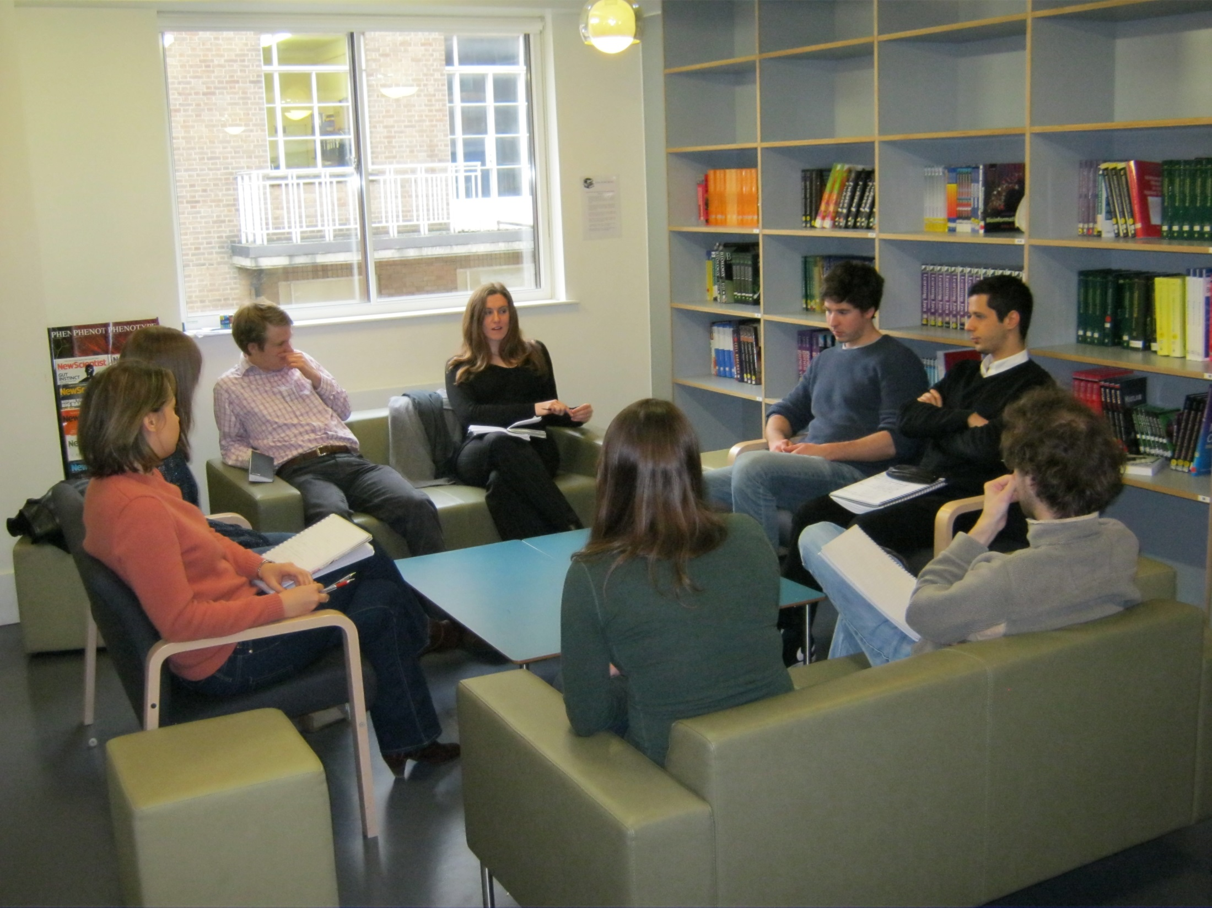
“Do you think you would be more confident in the future about trying to apply Open techniques to your work..?”
50% Yes, by myself
41% Yes, with help/guidance
9% No opinion/neutral
0% No

Slide 51
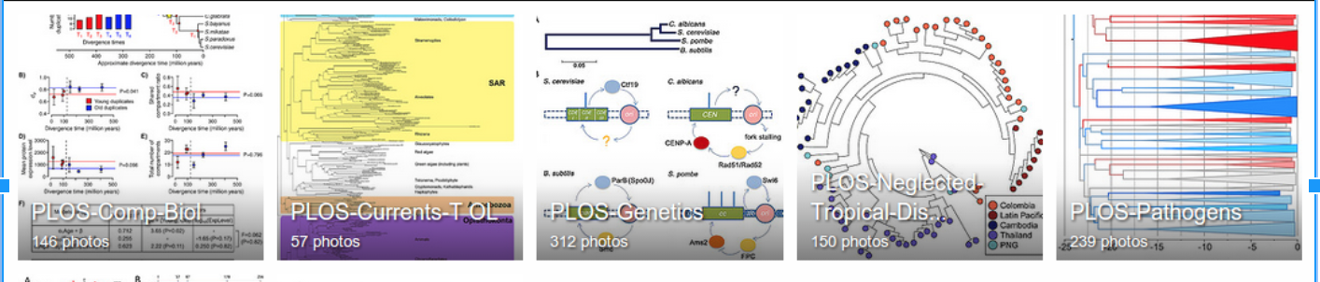
Ross Mounce (Bath), Panton Fellow
Sharing research data:
http://www.slideshare.net/rossmounce
How to figures from PLOS/One [link]:
Ross shows how to bring figures to life:
PLOSOne at http://bit.ly/PLOStrees
PLOS at http://bit.ly/phylofigs (demo)

Slide 52
Open Notebook Science
TOOLS
Open engineered
repository
validate
DATA
INSTRUMENT
merge
knowledge
DATA
calibrate
CC-BY
MODEL
CODE
Machines and humans
Working together
World
community
Problems are solved communally;
Nothing is needlessly duplicated; “publication“ is continuous

Slide 53
Content Mining
DATA
???
“Lab” work
Write
paper/thesis
publish
Intelligent software
To read scientific papers
DATA
Despite the inefficiency and loss much unused data remains
In published articles. Publishers have tried to stop us mining it.
On 2014-06-01 IT WILL BE LEGAL IN UK!

Slide 54
Content Mining
1,000,000 papers/year => 3,000 / day => 2 /min
10,000+ phylogenetic trees (Ross Mounce, BBSRC)
20,000 chemical reactions / day
>> 1 million graphs, plots, bar charts, statistics
Possible on a laptop
http://contentmine.org
Anyone interested in data from clinical trials papers?

Slide 55
AMI2: High-throughput extraction of semantic chemistry from the scientific literature
Andy Howlett, Mark Williamson, Peter Murray-Rust, Unilever Centre, Cambridge
Notes:
Hi, I’m here to talk about AMI; a data extraction framework and tool. First, I just want highlight some of key contributors to the projects; Andy for his work on the ChemistryVisitor and Peter for the overall architecture.
In this talk, I’m going to impress the importance of data in a specific format and its utility to automated machine processing. Then I’m going to demonstrate AMI’s architecture and the transformation of data as it flows through the process. I’m going to dwell a little on a core format used, Scalable Vector Graphics (SVG) before introducing the concept of visitors, which are pluggable context specific data extractors. Next, I’m going to introduce Andy’s ChemVisitor, for extracting semantic chemistry data, along with a few other visitors that can process non-chemistry specific data. Finally, I will demonstrate some uses of the ChemVisitor, within the realm of validation and metabolism.

Slide 56
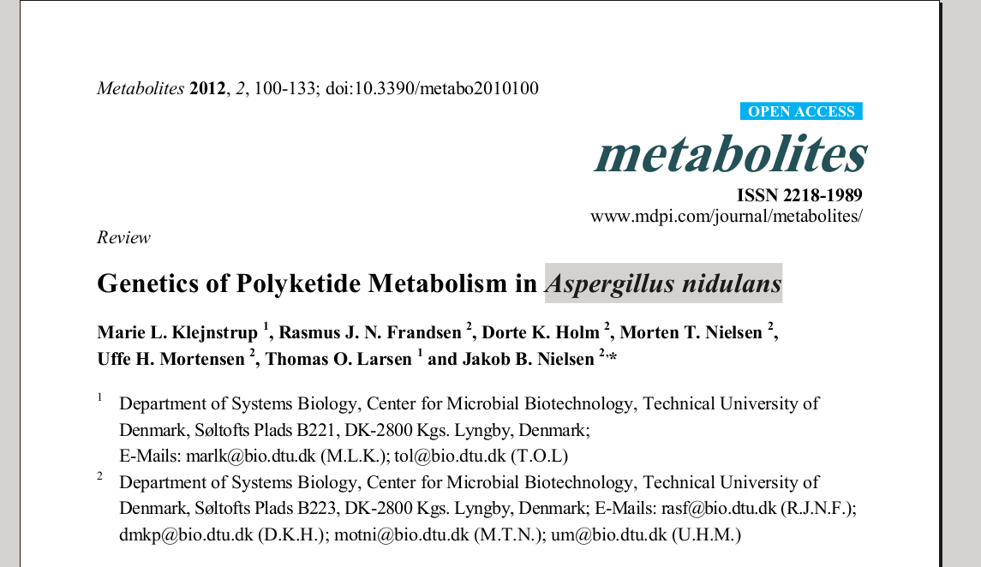
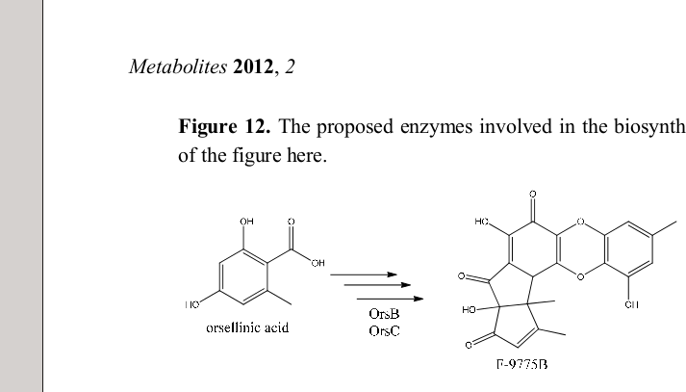
AMI2 is a framework that can extract semantic data from the scientific literature.
Notes:
As scientists, we publish our findings and data, and these generally manifest as PDFs on journals’ websites; ~60% of all documents are PDF. However, during this process, much information has been lost.. Hence a vast amount of Scientific knowledge has been rendered inaccessible.
AMI2 is a tool that is attempting to extract data, primarily (but not exclusively) from PDFs, to produce a format that is useful to automated processing. AMI is derived from the term amanuensis; someone who copies manuscripts. In a perverse way; this is attempting to make cows from beef burgers.
Dial-a-molecule is now involved

Slide 57
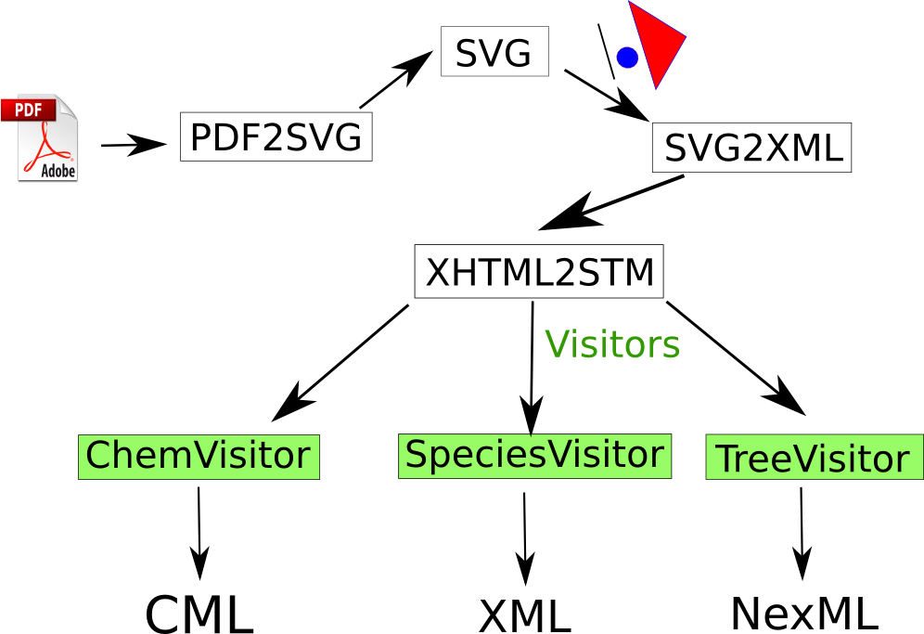
AMI2 architecture
Notes:
This is an overview of how the framework looks. The entire codebase is written in JAVA and is released under quite a generous Apache 2 license.
One pass over the information flow

Slide 58
Visitor Design Pattern/Example
Visitor = something that extracts a specific type of data
SpeciesVisitor, ChemVisitor, PhylogeneticTreeVisitor, GeoLocationVisitor, ClinicalTrialVisitor …
Visitable = something that can have specific data extracted
PDF, SVG, Table
Notes:
“Do the right thing” based on the type of two objects.
Talk more about design patterns
Two Abstract classes
Picked up via reflection

Slide 59
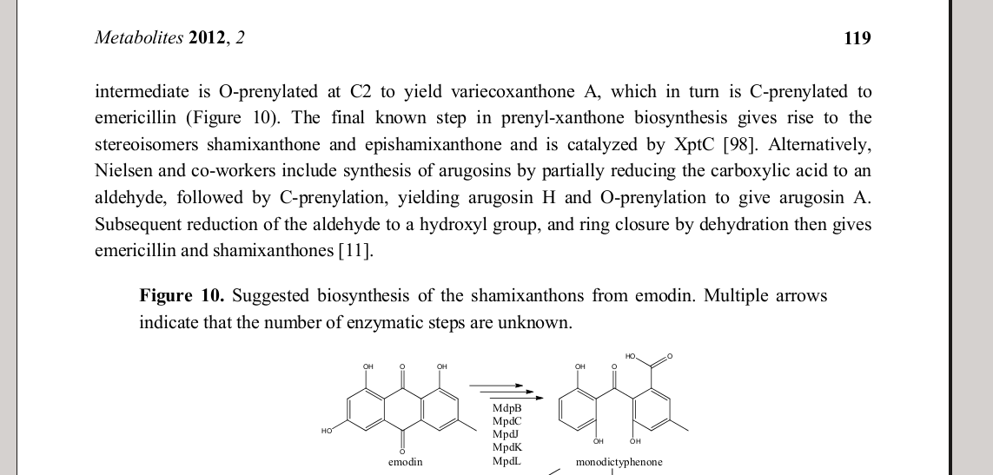
ChemistryVisitor
Can interpret diagram or look up chemistry in PubChem or ChEBI

Slide 60
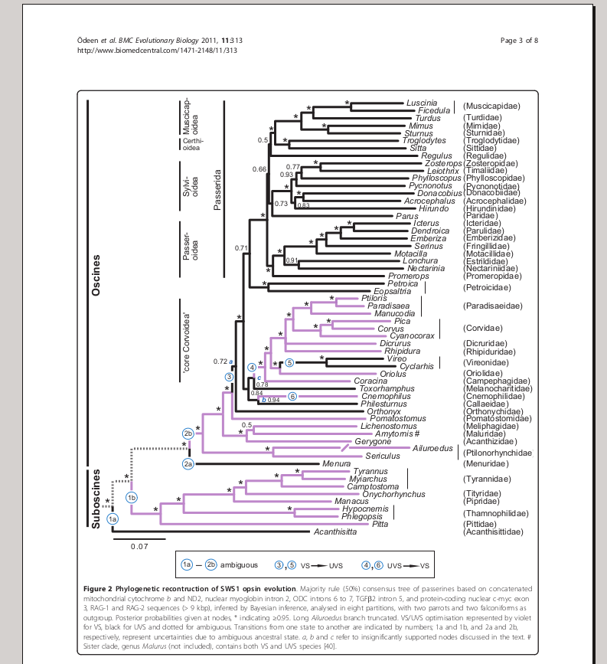
PhylogeneticTreeVisitor

Slide 61
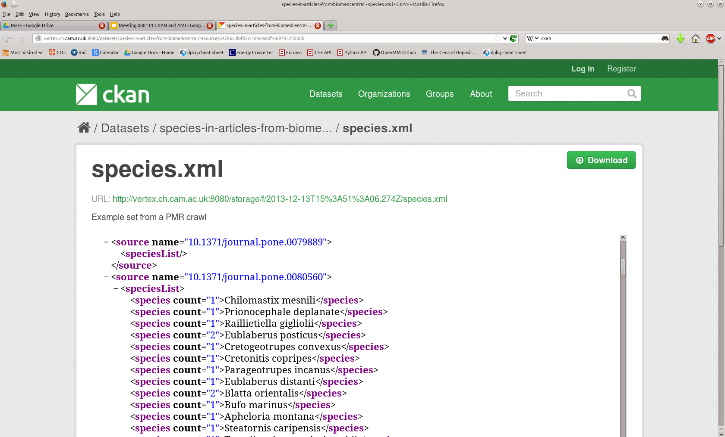
1) SpeciesVisitor
Notes:
Latin species name

Slide 62
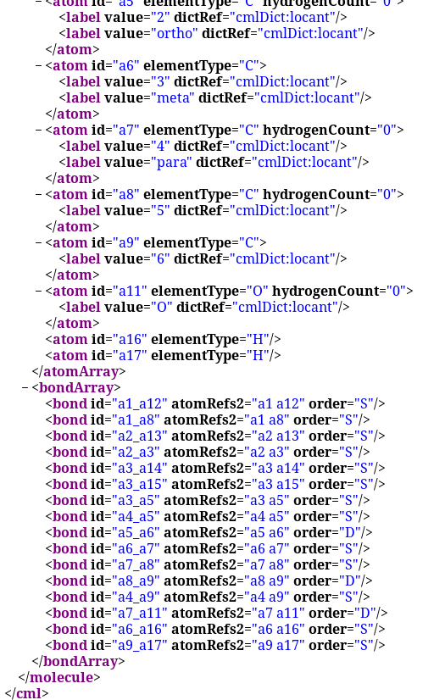
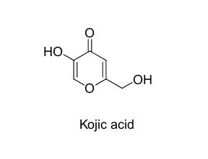
2) ChemistryVisitor
Notes:
Thus a ChemVisitor knows how to create a CMLMolecule from a SVGVisitable if it contains a picture of the molecule.
OSRA counter argument:not duplication, diversity, AMI has plugins,works with JAVA

Slide 63
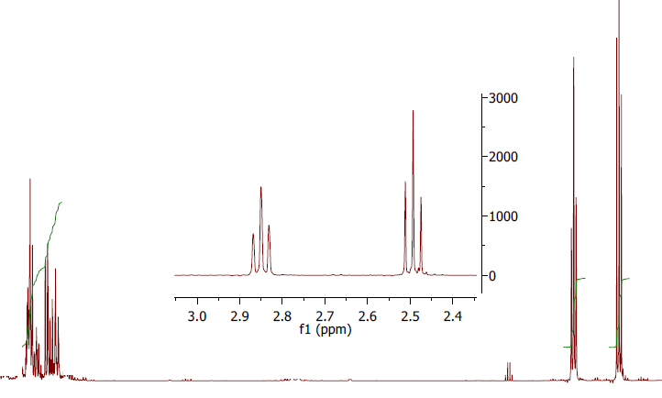
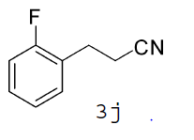
C) What’s the problem with this spectrum?
Original thanks to ChemBark
Org. Lett., 2011, 13 (15), pp 4084–4087
Notes:
ChemBark

Slide 64

After AMI2 processing…..
… AMI2 has detected a square

Slide 65


Slide 66
Thanks
BBSRC for PLUTo project (Bath)
Unilever Research for PhD (Andy Howlett)
TSB / Cambridge IP (PDRA Mark Williamson)
Shuttleworth Foundation (Fellowship PM-R)
Julian Huppert MP and David Willetts (support for Hargreaves copyright reform)
Christoph Steinbeck (EBI) Metabolights
The ContentMine team (Michelle Brook, Ross Mounce, Jenny Molloy, Richard Smith-Unna, CottageLabs)
The Blue Obelisk
Open Knowledge
Apache PDFBox and all F/LOSS software authors
Unilever Centre and University of Cambridge

Slide 67
CLOSED ACCESS MEANS PEOPLE DIE
Create Open Notebook Science in your discipline
Actively release data into Public Domain.
Actively campaign against any re-use restrictions (including CC-BY-NC)
Refuse to work with closed organizations
CLOSED DATA MEANS PEOPLE DIE

Slide 68
Some references
https://www.youtube.com/watch?v=BN8UjULNG9A&feature=youtube_gdata mins 5-9
http://web.ornl.gov/sci/techresources/Human_Genome/publicat/BattelleReport2011.pdf
http://footnote1.com/the-exploitative-economics-of-academic-publishing/
http://www.slideshare.net/rossmounce/sharing-reusable-phylogenetic-data-were-not-there-yet
http://usefulchem.blogspot.co.uk/2011/06/quest-to-determine-melting-point-of-4.html
http://www.slideshare.net/jcbradley/minisymp2011-bradley
https://impactstory.org/BlueObelisk

Slide 69
Open Science
Open engineered
repository
TOOLS
validate
DATA
INSTRUMENT
merge
knowledge
DATA
calibrate
MODEL
CODE
World
community
“Publication” is continuous and all “curious minds” can be involved.

Slide 70


Slide 71


3) PhylogeneticTreeVisitor
Notes:
Ross’ talk for example pictures
Phylogenetic trees to NeXML

